Slide 1
Conducting a Rural Health Clinic Mock Survey

Slide 2
Speaker
Tracie Ingram, BA
Community Health Ways Tri-Regional Supervisor
LDH/OPH Bureau of Regional and Clinical Operation

Slide 3
Mock Surveys in Louisiana
Rural Health Conference
June 22, 2023

Slide 4
AGENDA
Introduction​
Primary Objectives
​Reasons for Mock Survey
LA Requirements
General Requirements
​Resources

Slide 5
Introduction
Tracie L. Ingram worked for the Louisiana Department of Health for more than 25 years, serving as Rural Health Officer from 2009 to May 2021. In this role, she worked primarily with the state’s small rural hospitals, critical access hospitals, rural health clinics, and Federally Qualified Health Centers with a focus on rural healthcare access and sustainability. Tracie has performed mock surveys for over 15 years.

Slide 6
Disclaimer
This presentation is intended to be educational in nature. It is not all-inclusive of all aspects of RHC surveys. It is a general guideline to help Rural Health Clinics and potential Rural Health Clinics get and maintain survey preparedness. It is the clinic’s responsibility to follow all state and Federal Licensing and Certification Requirements.

Slide 7
PRIMARY Objectives
Reasons to do a Mock Survey
Louisiana Requirements (Aren’t We Special)
Parts of a RHC Survey Overall
Resources

Slide 8
Reasons to perform a Mock Survey?
Surveys are Required for Initial RHC Licensing and Maintaining RHC License
Prepare your staff for survey
Better Patient Care
Know Where You Are Going
Quality Improvement
Patient Centered Medical Home
Expansion of Services
Assess staffing needs

Slide 9
“BUSINESS OPPORTUNITIES ARE LIKE BUSES. THERE'S ALWAYS ANOTHER ONE COMING.”
--Richard Branson
SURVEYS ARE LIKE BUSES. THERE'S ALWAYS ANOTHER ONE COMING. BE PREPARED FOR THE RIDE. HOW BUMPY THAT RIDE IS DEPENDS A LOT ON YOU. --Tracie’s Viewpoint

Slide 10
Louisiana Special Requirements
Louisiana (unlike most states) has a state licensing process.
See Health Standards Presentation on Louisiana Survey Process
Louisiana Specific Requirements:
Workplace violence policy and poster
Act 461 of 2022 Legislative Session Workplace Violence | La Dept. of Health
Act 461 enacts reforms to address workplace violence in healthcare settings, including but not limited to establishing duties and requirements of licensed healthcare facilities with respect to addressing and preventing workplace violence; requiring the posting of certain cautionary signage at licensed healthcare facilities; requiring reporting of acts of workplace violence occurring at licensed healthcare facilities; prohibiting retaliation by certain employers in connection with reporting of healthcare workplace violence; requiring the Louisiana Department of Health to maintain on its website public information regarding healthcare workplace violence; and authorizing enforcement actions by the Department.

Slide 11
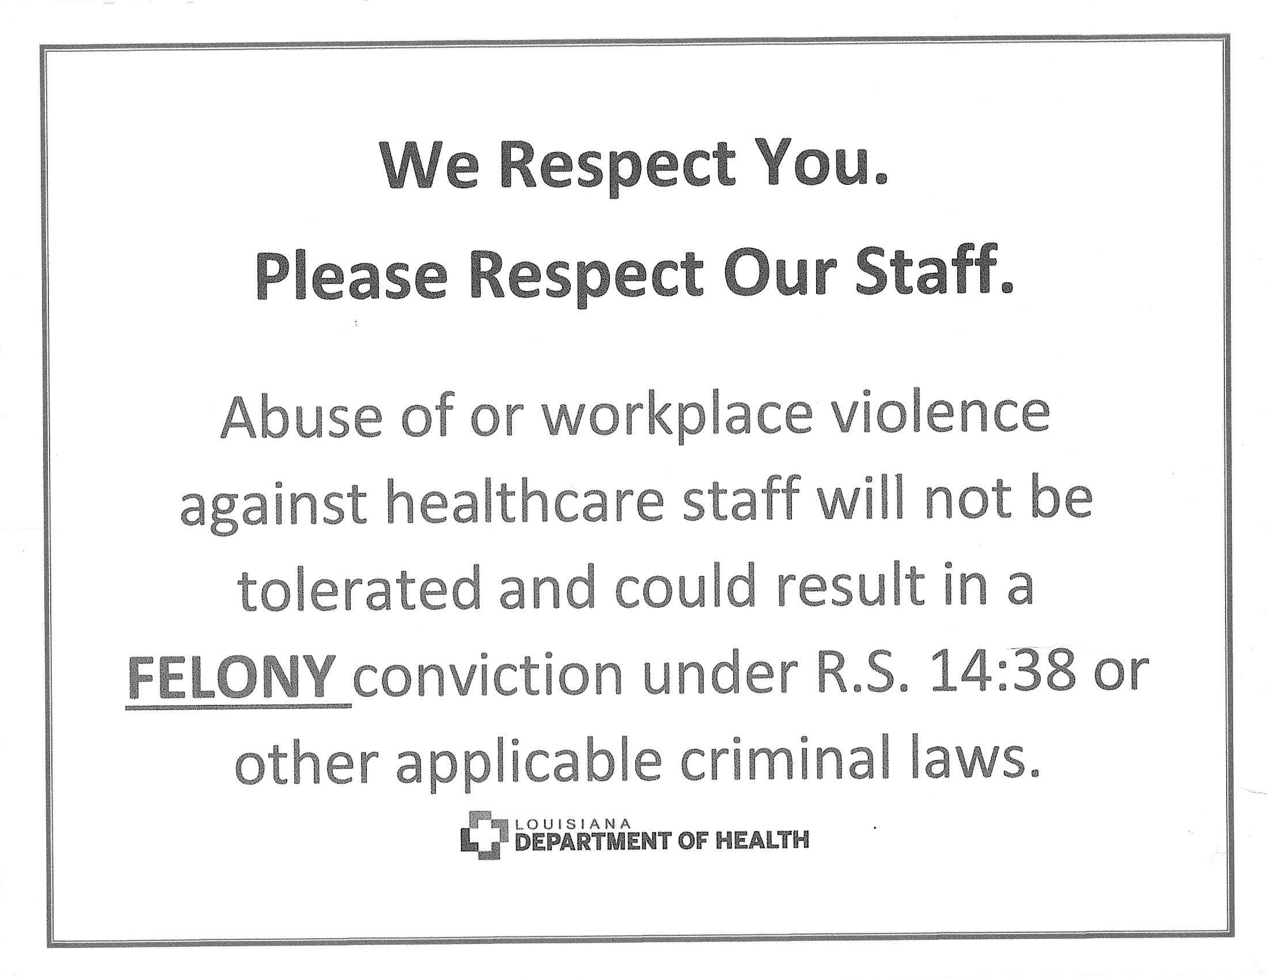
Louisiana special requirements
Act461-Sample-Healthcare-Workplace-Violence-Signage.pdf

Slide 12
Louisiana special requirements
Background check on all staff that have contact with patients
Criminal Background Check Information | La Dept. of Health
Effective June 2, 2016, Act 311 amended La RS 40:1203.1-2 requiring that licensed health care providers shall request that a criminal history and security check be conducted on the non-licensed person, prior to any employer making an offer to employ or to contract with a non-licensed person or any licensed ambulance personnel to provide nursing care, health-related services, medic services, or supportive assistance to any individual and in accordance with La RS 40:1203.1-5.

Slide 13
Louisiana special requirements
Yearly requirements (that are different from most states)
Governing Body:
Governing Body. All owners of a Rural Health Clinic shall be disclosed. Ownership of five percent or more Title 48, Part I 535 Louisiana Administrative Code February 2022 constitutes ownership. In the case of a corporation, members of the board of directors must be identified and minutes of the board meetings shall be made available to DHH/HSS. The board shall meet at least once a year.
Note: Emergency Preparedness now aligns will Federal Regulations (every two years)

Slide 14
Louisiana Special requirements
Advisory Committee
All members of the advisory committee shall be designated in writing and approved by the governing board. The advisory committee shall be composed of two medical professionals and at least one consumer of services, not employed by the facility. However, facility staff should attend meetings.
Qualifications:
Medical professionals may be any Louisiana licensed health care professional, including but not limited to, medical doctor, registered nurse, board certified social worker, pharmacist, or physical therapist.
Consumers must be members of the local community, over 21 years of age, and not affiliated by employment, family, finance or contract with the facility or its owners.
2. Responsibilities: The Advisory Committee shall:
meet annually to review the facility's mission/philosophy, operations, finances, policies, and planned activities to assure that the facility is improving access and health care to the community; and
provide suggestions regarding facility changes based upon community needs, growth, and support.

Slide 15
Louisiana Regulations
Utilization Review
At least 10 percent of all encounters shall be reviewed quarterly by the medical director and/or physician member of the advisory board.
Annual Evaluation
Facility shall develop and conduct an annual internal evaluation process to provide necessary data to formulate a plan for continuous quality improvement/quality assurance.
On-site Physician Supervision Every Two Weeks
The physician shall provide onsite supervision of the mid-level practitioner(s) as required by the payment source and professional boards or at least every other week. All rural health clinic records and care provided by a mid-level practitioner(s) shall be assessed by a physician on a periodic basis or as the situation dictates to assure proper treatment and progress toward positive patient outcomes.

Slide 16
Survey parts and pieces
Human Resources
Emergency Preparedness
Policies and Procedures
Site Walk through
Patient File review
Do you have all the required information?
Have you done your required exercises?
Review both State and Federal Policy Requirements
Physical Inspection of the Clinic
Are your charts being documented completely and timely?

Slide 17
Survey parts and pieces
Staff Interview
Exit Interview
Follow-up
Paperwork process
Changes?
Surveyors will interview provider and non-provider staff
Review of deficiencies found
(if any)
Review both State and Federal Policy Requirements
Is a Plan of Correction Required or possibly a Re-Survey?

Slide 18
Human Resources
See Rural Health Clinic Survey Presentation (TCT)
Check with Your Accreditation Organization
Required Documents
I-9 & W4 (Remember you must have one employed Mid-Level Provider)
Application, Resume, or CV
Job Description-signed
License or Certification (as required by position, number, & expiration date)
DEA number and expiration (as applicable)
Basic Life Support Proof of class and expiration date
Background Check (especially important in Louisiana)
OIG Exclusion
Orientation checklist, Training, Competency Check
Standard of Conduct-signed
Typically kept separately but must have:
Performance Evaluation
Verification of TB check or signed declination
Verification of Hepatitis B Check or signed declination

Slide 19
Emergency Preparedness
RHC Regulation - National Association of Rural Health Clinics (narhc.org)
From NARHC’s Website:
The Rural Health Clinic/Federally Qualified Health Center (RHC/FQHC) must comply with all applicable Federal, State, and local emergency preparedness requirements. The RHC/FQHC must establish and maintain an emergency preparedness program that meets the requirements of this section.
The emergency preparedness program must include, but not be limited to, the following elements:
Emergency plan—The RHC or FQHC must develop and maintain an emergency preparedness plan that must be reviewed and updated at least every 2 years.
Policies and procedures—The RHC or FQHC must develop and implement emergency preparedness policies and procedures, based on the emergency plan set forth in paragraph (a) of this section, risk assessment at paragraph (a)(1) of this section, and the communication plan at paragraph (c) of this section. The policies and procedures must be reviewed and updated at least every 2 years.
Communication plan—The RHC or FQHC must develop and maintain an emergency preparedness communication plan that complies with Federal, State, and local laws and must be reviewed and updated at least every 2 years.

Slide 20
Emergency Preparedness
Training and testing. The RHC or FQHC must develop and maintain an emergency preparedness training and testing program that is based on the emergency plan set forth
Provide emergency preparedness training at least every 2 years. (iii) Maintain documentation of the training.
Testing. The RHC or FQHC must conduct exercises to test the emergency plan at least annually. The RHC or FQHC must do the following:
Testing: Participate in a full-scale exercise that is community-based every 2 years; or
(A) When a community-based exercise is not accessible, an individual, facility-based functional exercise every 2 years; or (B) If the RHC or FQHC experiences an actual natural or man-made emergency that requires activation of the emergency plan, the RHC or FQHC is exempt from engaging in its next required full-scale community-based or individual, facility-based functional exercise following the onset of the emergency event.

Slide 21
Emergency Preparedness
AND…
(ii) Conduct an additional exercise every 2 years, opposite the year the full-scale or functional exercise under paragraph (d)(2)(i) of this section is conducted, that may include, but is not limited to following:
(A) A second full-scale exercise that is community-based or an individual, facility-based functional exercise; or (B) A mock disaster drill; or (C) A tabletop exercise or workshop that is led by a facilitator and includes a group discussion, using a narrated, clinically-relevant emergency scenario, and a set of problem statements, directed messages, or prepared questions designed to challenge an emergency plan.

Slide 22
Policies and Procedures
Check state and Federal licensing Regulations: Rural Health Clinics | La Dept. of Health
See Survey Presentation (TCT)
This is not intended as a list of all required policies, but as guidance
Make Your Policies and Procedures Site Specific (especially emergency preparedness)
Lots of resources for Policies and Procedures-but you must make them applicable to your site
Must be signed off on originally and yearly by Medical Director and Mid-Level Provider
Keep them easily readable and accessible to employees
Change as needed and get approval
Document changes and that your staff have been trained on any new policies and or procedures
Do not have a policy or procedure that your clinic does not follow
Assure your Policies and Procedures match
If it’s in policy, you must be able to show proof of your implementation
Example: Fire Drills—If you have a policy that your clinic has quarterly fire drills, then you must have documentation that those are done.
Example 2: Policy on equipment (disposable vs non-single use equipment)

Slide 23
Physical Environment
General Guidance
See Survey Presentation (TCT)
First Impressions Matter
Clean and Orderly Environment
Medications, Medications, Medications
In date
Stored correctly
Single Dose vs. Multi-Dose Vials (One of the most frequent deficiencies)
Process for checking medications
How often
Who’s checking
Medication Disposal Process
Supplies
In date
Equipment
Inspected, documented
Sanitation

Slide 24
Patient Chart Reviews
Must now review 20 Patient Charts
Looking For Completeness, follow up, and follow through
Consent (What’s your policy and are you following it)
Patient ID and Social Data
Health History
Health Status & Needs (Chief Complaint)
Plan of Care and Patient Instructions
Physician’s Orders
Were any Labs or Diagnostics done? If so:
Were they completed?
Documented follow up /contact if not completed (What’s your process?)
Results in Chart
Results communicated to patient?
Signed off (timely) by Provider?

Slide 25
Staff Interviews
Providers
Everyone
Schedules
Treatment Guidelines/Reference
Medical Director Availability/Collaboration
Oversite & Feedback
Infection Control Procedures
Competency Trainings
Policy and Procedures being followed
Emergency Management
Responsibilities

Slide 26
Exit Interview
Ask questions
Surveyor will go over cited deficiencies
Anyone can be present at this meeting
Surveyor will tell you process that happens after survey

Slide 27
Paperwork
Surveyor will submit report
If any deficiencies, they will be finalized as well as the level
Survey organization will send you a notice of the deficiencies, the level and request a plan of action
Standard level deficiencies require a plan of correction
Condition Level deficiencies require a second site survey to follow up on cited deficiencies
Once all that is resolved, the report will be submitted to CMS. They will look at all paperwork (CLOSELY) and send the clinic a report and next steps (this is usually sending you your new Medicare RHC license-if initial survey, or continuation notice).

Slide 28
Changes
Change what you need to. Make sure to train staff and embed these changes into your practice
After your mock survey (or real survey) it is a perfect time to consider what changes you’d like for your clinic
Additional Staff
Additional Training
Expansion of Service
Patient Centered Medical Home (PCMH)
NOTE: If you ever decide to change locations of your RHC, make sure to get a new Site Verification Letter and notify Health Standard FIRST—Otherwise, you could lose your RHC license.

Slide 29
THANK YOU
Tracie Ingram​
For The State Office of Rural Health
Tracie.Ingram@la.gov
Phone: 985-974-0086

Slide 30
Resources
Health Standards LA Rural Health Clinics Page:
Rural Health Clinics | La Dept. of Health
Criminal Background Check Information
Criminal Background Check Information | La Dept. of Health
Workplace Violence Information and Poster
Workplace Violence | La Dept. of Health
Louisiana Rural Health Association
Louisiana Rural Health Association - Home (wildapricot.org)
National Association of Rural Health Clinics
Home - National Association of Rural Health Clinics (narhc.org)

Slide 31
Questions?

Slide 32
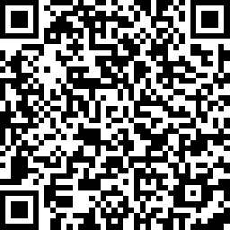
We want to hear from you!
https://www.surveymonkey.com/r/BSVCGV6
Notes:
Speaker: Please complete the post session survey to share your feedback. To access the survey, you can scan the QR code on this slide with the camera on your mobile phone! The survey should only take a minute or two to complete. Thank you!

Slide 33
Thank you for joining us!

