Slide 1
ECHO: A New Way of Learning

Slide 2
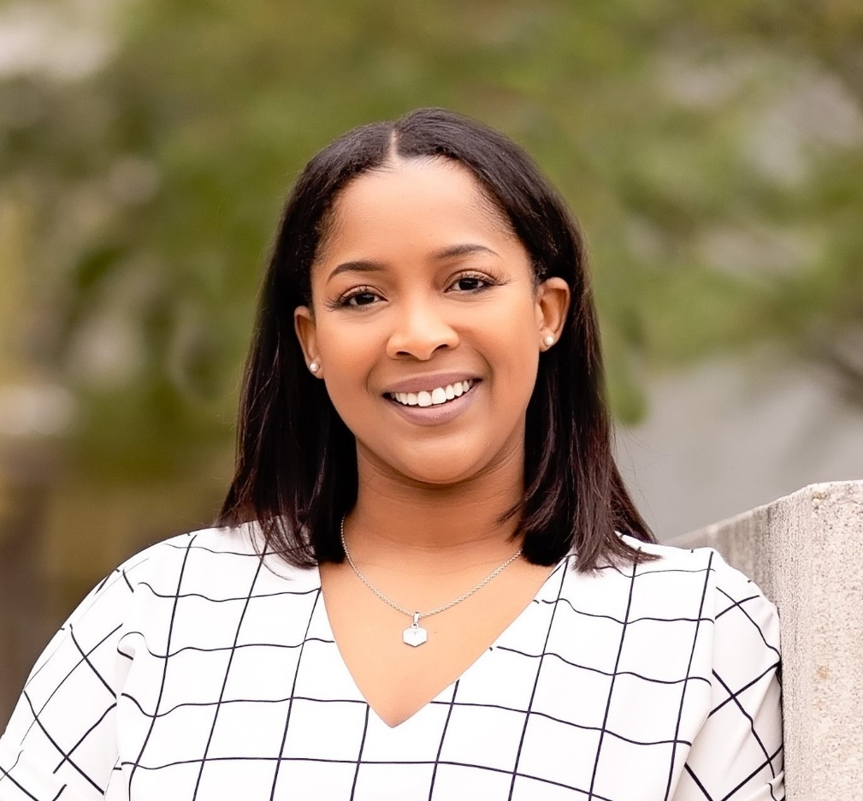
Speaker
Taunya Williams, MHA
Healthcare Innovation Manager
Well-Ahead Louisiana

Slide 3
Learning Objectives
Overview of the Project ECHO Model
Benefits of participating in an ECHO project
Structure of an ECHO session
Review of the Well-Ahead Louisiana ECHO projects
Notes:
Session Description (3-5 Sentences): ?

Slide 4
What is ECHO?
This is a movement to demonopolize knowledge and amplify the capacity to provide best practice care for underserved people all over the world.
The model connects providers and specialists on a live, virtual platform to share knowledge and expand treatment capacity.
It gives providers the knowledge and support they need to manage patients with common and complex conditions in the patients’ own communities.
Notes:
First I will start off with a brief explanation of Project ECHO. This has been made possible through a partnership between Well-Ahead Louisiana and Project ECHO® with the University of New Mexico. Through these virtual knowledge-sharing networks, providers receive training and tele-mentoring. The model connects providers and specialists on a live, virtual platform to share knowledge and expand treatment capacity in rural communities.
Project ECHO was created in 2003 to deliver specialized medical knowledge to rural health care providers. Nearly 20 years ago, Dr. Sanjeev Arora walked into his clinic to find a 43-year-old woman with hepatitis C seeking treatment for the first time, after an initial diagnosis eight years earlier. When questioned why she would delay treatment, she said she couldn’t afford to take the time off of work to make the five-hour trip to Albuquerque; she was also a widow with two children to care for. She finally sought help when her abdominal pain began interfering with her ability to work. But it was too late. The untreated hepatitis C had caused advanced liver cancer that was not suited for surgery or liver transplantation. She died six months later. That's why he created the ECHO Model, an infrastructure for knowledge-sharing.
Through ECHO, professionals learn and share best practices in health care, education and more. ECHO has proven effective across multidiscipline and geographies as a way to reduce disparities, strengthen health systems and drive collaborative solutions for local priorities. The ECHO model supports ongoing learning and assistance for healthcare professionals to improve patient centered care.

Slide 5
What is ECHO?
ECHO functions on a “hub and spoke” model
Hub Team is made up of a group of relevant specialists
Spoke Sites are community providers/clinics
ECHO sessions function like virtual grand rounds
Spoke sites will present cases and participate regularly
Specialists serve as mentors and experts
ECHO model is not “traditional telemedicine”
Notes:
Regardless of the focus of the particular ECHO program, they all function on what we call a hub and spoke model. The Hub Team is made up of a group of specialists that are relevant to the focus area of that particular ECHO program. The Spoke Sites are all community provider, clinics, or organizations, who register and join. The Hub Team Members and the Spoke participants come together regularly at the ECHO Sessions to share knowledge and best practices. The model is designed to create a learning loop where knowledge is flowing among all the participants so everyone is teaching and everyone is learning from each other.
We’ll get into more detail about the session structures later in the presentation but, at a high level, the sessions function like virtual grand rounds with mentoring and case presentations. Spoke Sites present cases to the group and all participants, both spoke and hub, discuss the case and provide recommendations. The individual who presents the case can then consider all of the input and recommendations from the other participants and from the different specialists on the Hub team and determine the best course of action.

Slide 6
All Teach, All Learn
Notes:
Due to the simplicity and low cost of the model, Project ECHO has great potential for application in rural and underserved communities. The knowledge gained empowers providers to lead positive and sustainable change in their communities.
These regularly scheduled videoconferencing sessions include subject matter experts and learners who use the ECHO model to present brief lectures and case-based learning to create learning loops. The goal of the ECHO sessions is to create these learning loops where all providers learn from and teach each other. Our motto is “All Teach, All Learn”
The spoke sites are made up of community professionals, in our case, from across Louisiana. The Hub Team, which in our case is virtually housed at Well-Ahead, includes several relevant specialists or subject matter experts, as well as a Coordinator that helps to run and support the sessions.

Slide 7
Notes:
Project ECHO follows 4 principles. The use of technology to leverage resources is the first principle. And of course we want to ensure that anything that we are sharing is best practice and helps to reduce health disparities. As I mentioned, the sessions focus around case presentations to drive discussion, sharing, and learning. And the final principle is evaluating and monitoring outcomes.

Slide 8
Benefits of ECHO
Democratize Knowledge
Quality and Safety
Rapid Learning and best-practice dissemination
Reduce variations in care
Access for Rural and Underserved Patients, reduced disparities
Workforce Training and Force Multiplier
Improving Professional Satisfaction/Retention
Supporting the Medical Home Model
Cost Effective Care–Avoid Excessive Testing and Travel
Prevent Cost of Untreated Disease (e.g. liver transplant or dialysis)
Integration of Public Health into treatment paradigm

Slide 9
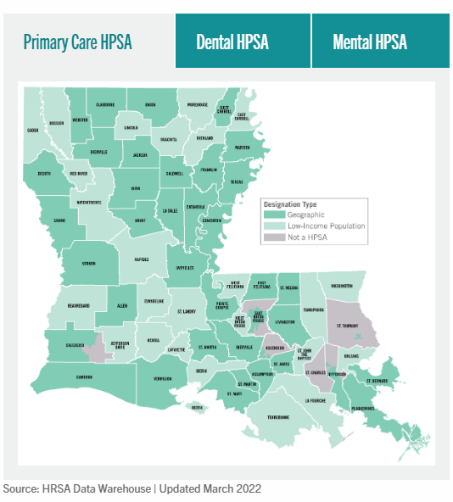
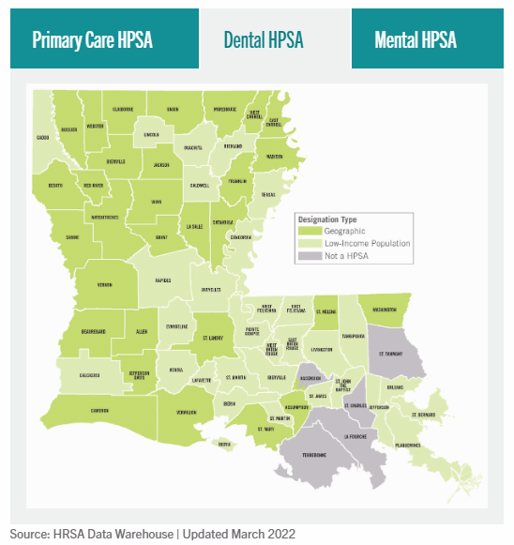
Need for ECHO in Louisiana
Notes:
These images show the Health Professional Shortage Areas in Louisiana. The ultimate goal of Project ECHO is to provide the same level of healthcare to rural patients with chronic diseases as can be obtained in an urban setting. A secondary goal is to provide healthcare practitioners in rural communities with a level of interaction and support as their urban counterparts to enhance their technical competence and decrease their feelings of professional isolation.

Slide 10
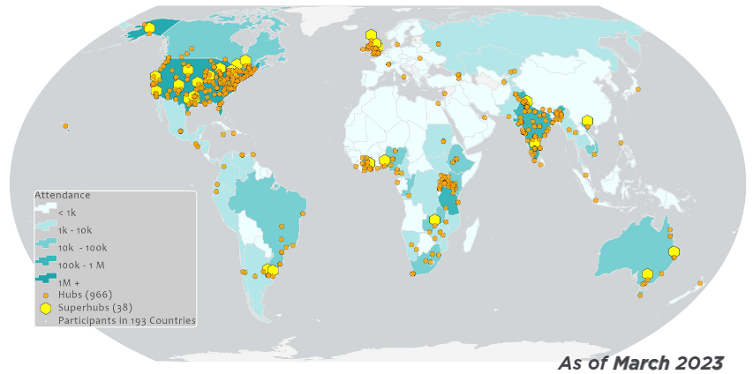
Where it’s Used – Nationally and Globally
Notes:
Project ECHO has seen enormous expansion and is now used in a lot of very diverse ways, not only in healthcare. The program is now used across the US and the world.

Slide 11
Basic ECHO Session Structure
Welcome & Introductions
Case Presentation
Clarifying Questions
Case Discussion and Recommendations
Didactic Presentation
Wrap-up and Reminders
Notes:
Each session begins with introductions of all participants. Participants then present a pre-submitted case for discussion by the entire group, using de-identified information only. Recommendations are summarized verbally at the conclusion of a case presentation, transcribed, and forwarded in writing to the healthcare provider whose case was discussed. Following the case presentation and subsequent recommendations, there will be a short 10-15 minute formal didactic presentation on a scheduled topic by Hub Team members or other subject matter experts. After the didactic presentation, we wrap up the session and may give some announcements.

Slide 12
Continuing Education Units (CEUs)
We offer FREE professional continuing education credits to physicians, physician assistants, nurses/nurse practitioners, pharmacists, dentists, dental hygienists and Certified Health and Education Specialists (CHES).
We are able to provide CEUs through the University of New Mexico.
Project ECHO® is jointly accredited by the Accreditation Council for Continuing Medical Education (ACCME), the Accreditation Council for Pharmacy Education (ACPE), the American Nurses Credentialing Center (ANCC), and the American Association of Physician Assistants (AAPA), and ADA CERP Recognized Provider to provide continuing education for the healthcare team.
Notes:
We offer continuing education credits for several types of providers. In order to obtain CEUs we require that participants attend at least 30-45 minutes of the 1 hour session, put their contact information in the chat box for attendance, and complete the post-session survey by the deadline after each session. The link for to obtain CEU credits is provided in the chat box during the session and via email after each session. In support of improving patient care, this activity has been planned and implemented by the Louisiana Department of Health, Bureau of Chronic Disease Prevention and Healthcare Access and Project ECHO®.

Slide 13
Participation Requirements
Each registered provider must complete two surveys to assess efficacy of the program: one pre-survey prior to the first session and one post-survey after the last session
Attend and actively engage in at least 50% of sessions
When requested, present at least 1 case during the calendar year
Individual providers must complete a post-session survey for each session attended in order to obtain FREE continuing education credits for the session
Notes:
Participation requirements for all ECHO projects include:
- Each individual provider must complete one pre-survey and one post-survey to assess efficacy of the program
- Attend and actively engage in at least 50% of sessions
- When requested, present at least 1 patient case during the calendar year; but you are allowed to submit more than one case if we have openings
- Individual providers must complete post-session surveys in order to obtain FREE continuing education credits

Slide 14
Diabetes ECHO
Utilizes case-based learning of patients living with diabetes and to assist primary care clinicians in gaining expertise in the care and management of diabetes and diabetes-related conditions
Sessions are held twice a month for one hour via zoom
Well-Ahead Louisiana serves as the “hub” of specialists, including an Endocrinologist, an Internal Medicine Physician, a Certified Diabetes Educator, a Nurse Practitioner, and a Cardiologist and a Podiatrist
Notes:
Diabetes ECHO is designed to provide a consultative link between specialists and community clinicians throughout the state. Its goal is to provide consultations through case review of patients living with diabetes and to train primary care clinicians to become experts in the care and management of diabetes and diabetes-related conditions so that patients can receive timely treatment in their own communities. The goal is the increase provider confidence and self-efficacy in treating patients with diabetes. We also aim to improve A1c control and other health outcomes among adults with known diagnosis of diabetes. Sessions are held every other Thursday of each month from noon-1:00 PM. Physicians, physician assistants, nurses, nurse practitioners and pharmacists are able to obtain CEUs for their participation

Slide 15
Dental ECHO
The Dental ECHO project will allow providers’ to acquire new skills, competencies, and best practices in patient care related to oral health.
Well-Ahead Louisiana serves as the “hub” of specialists, including two dentists, a dental hygienist, and a LSU School of Dentistry professor
Sessions are held once a month for one hour via zoom
Notes:
Louisiana has a history of poor access to oral health services including dental care. In Louisiana, 86% of our parishes are Dental Health Professional Shortage Areas, meaning the majority of our state does not have access to the dental care they need. By mobilizing diverse providers and collaborative efforts, this will improve access to preventative oral health care in Louisiana and therefore improve the lives of underserved Louisianans. This project will provide dentists with the knowledge and support they need to manage patients in Dental HPSAs. Any Louisiana healthcare provider who works directly with patients living with oral health issues or has an interest in expanding their knowledge base can participate. We also aim to tie in medical/dental integration with this provider education. Sessions are held on the third Friday of each month from 3:00 PM-4:00PM. Dentists and dental hygienists are able to obtain CEUs for participation

Slide 16
Lifestyle Coach ECHO
During each session, a spoke sites will present patient cases and participants will discuss and help determine the best way to support the National Diabetes Prevention Program participant.
Sessions are held once a month for one hour via zoom
Well-Ahead Louisiana serves as the “hub” of specialists, including our partners Diabetes Training and Technical Assistance Center (DTTAC) at Emory University
Notes:
Well-Ahead Louisiana has partnered with Diabetes Training and Technical Assistance Center (DTTAC) at Emory University. During each session, participants will discuss and help determine the best way to support a National Diabetes Prevention Program participant. This project enables coaches to expand their knowledge and more confidently support program participants, creates a supportive network of peers and community of practice and learning. The subject matter experts at DTTAC will serve as mentors and colleagues, sharing their knowledge and expertise with participants, and also present educational presentations during each session. Sessions are held on the Second Wednesday of each month from 1:00 PM-2:00PM. Certified Health and Education Specialists are able to obtain CEUs for participation

Slide 17
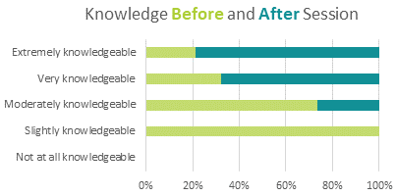
Project ECHO Outcomes for Well-Ahead
This session has increased, improved, or positively impacted my:
Notes:
Our evaluation team, rigorously evaluates our programs and participant knowledge and satisfaction. This has provided us with great feedback about our program and its impact.
Participants increased their knowledge 26% after participating in the ECHO
96% say they probably or definitely will use what they learned in the sessions in their work
Common examples of how they will use what they have learned include: utilizing resources from the sessions, better understanding of diabetes medications, collaboration with other staff and team members, and better understanding patient’s barriers

Slide 18
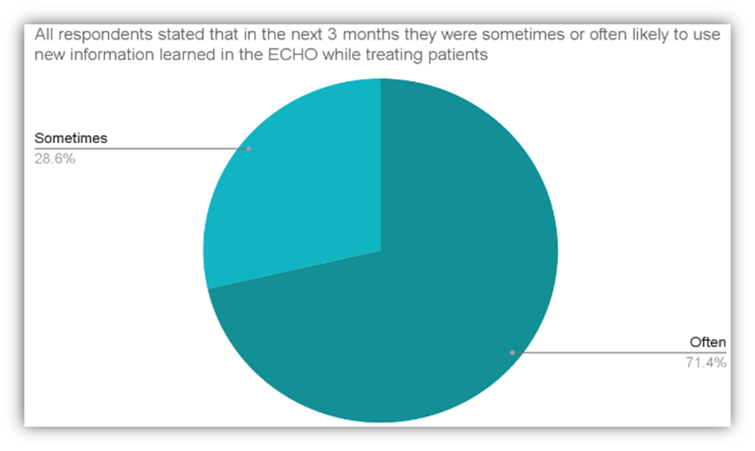
Notes:
This graph shows that 71.4% of respondents stated that in the next 3 months they were likely to use new information learned in the ECHO program while treating their patients. Participants have stated that increasing their knowledge by attending each session, better prepares them to educate and care for their patients.

Slide 19
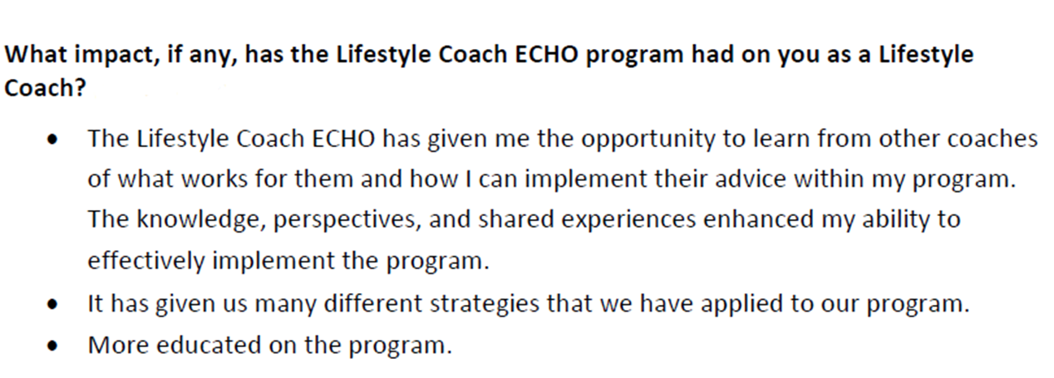
Project ECHO Outcomes for Well-Ahead
Notes:
To conduct the ECHO evaluation we use a combination of quantitative and qualitative tools and methods. Our evaluation measures have shown that providers learn from one another and build a supportive network due to their participation in our program. They report gaining knowledge, education and strategies from Project ECHO.

Slide 20
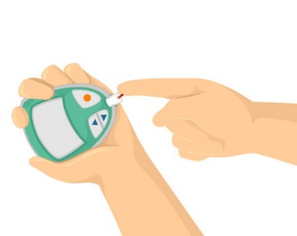
Project ECHO Outcomes for Well-Ahead
Diabetes ECHO Testimonial:
“Improved Diabetic outcomes for difficult patients. These patients had A1c's in the range of 10-12.5% during the months of June and July. Education, follow-up clinic and virtual visits, including remote monitoring over a six month period, resulted in 6.5 and 7.0% A1c. These patients also tolerated Thanksgiving and Christmas holidays. The education received during the year from the ECHO clinic provided resourceful information to assist our patients.”
Notes:
This is a testimonial from one of our Diabetes ECHO participants this year. The knowledge this individual gained during our sessions improved health outcomes for their patients with elevated A1c’s. This reduces the need for the patient to travel outside of their community for specialty care.

Slide 21
Key Takeaways
ECHO model is an effective tool to train specialists in areas of our state that are predominately rural
All Teach, All Learn
Providers gain free continuing education credits
Moving Knowledge not People
Get involved or inquire about how you can start your own ECHO program
Notes:
Here are a few takeaways from my presentation. I hope you’ve received an overview of project ECHO, what it is, how it works, and the benefits of participating.
There is an increasing need for organizations to utilize high-quality tele mentoring models to support workforce development and mentorship. The ECHO model supports ongoing learning and support for clinicians so they can provide the best possible care to their patients in their communities, reducing the need for patients to travel outside of their communities to see specialists. The model helps to create a supportive network of providers through knowledge sharing and relationship development. Participants are encouraged to attend as many sessions as possible to get the full benefits of the program.
Rural providers benefit the most from Project ECHO because the goal is to move knowledge your patients. To find out more about how you can get involved, feel free to reach out for more information.

Slide 22
Contact Information
Taunya Williams, MHA, Healthcare Innovation Manager, Well-Ahead Louisiana
Taunya.Williams@la.gov

Slide 23
Questions?

Slide 24
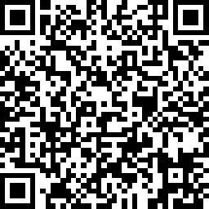
We want to hear from you!
https://www.surveymonkey.com/r/RCYLXYT
Notes:
Speaker: Please complete the post session survey to share your feedback. To access the survey, you can scan the QR code on this slide with the camera on your mobile phone! The survey should only take a minute or two to complete. Thank you!

Slide 25
Breakout Sessions: 11:00 a.m. – 12:00 p.m.
Notes:
Thank you SPEAKER.
The next breakout sessions begins at 11am.
Page 5 of the Agenda lists the different sessions you can choose from and their locations.
Thank you!

