Slide 1
Grantsmanship: De-Mystifying the Process on YOUR Terms

Slide 2
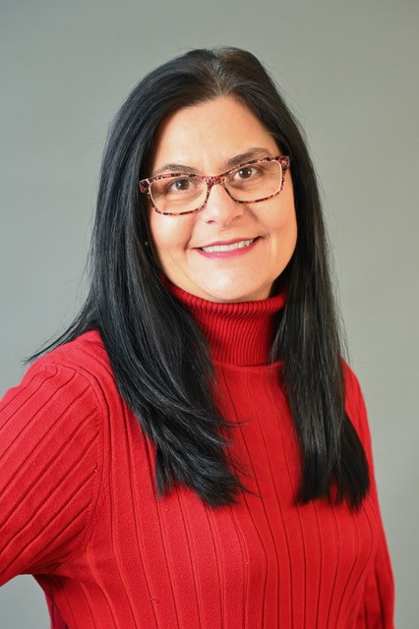
Speaker
Laura Newberry Wilson, BS
J2 Strategic Solutions
Director of Patient Safety
LHA Trust Funds

Slide 3
GRANTSMANSHIP
De-mystifying the Process
on YOUR terms.
Laura Newberry Wilson, BS

Slide 4
OBJECTIVES
Participants will learn about the basic stages of the grants process: pre-grant, grant writing, and post-award.
Participants will learn about hazards that impede success as well as industry tips to increase the chances of award.
The session will be interactive and prompt attendees to formulate their own questions based on current needs so they can be addressed by a grant writer/reviewer prior to the session’s end.

Slide 5
What to Expect
This will be customized to you. This is YOUR time.
I want your questions. Feel free to ask your questions during the discussion or use the paper and jot your questions down. We will address them in real-time or during our Q&A.
Please complete the sign-in sheet. I will send an email of any remaining questions and their answers to the group.
This is meant to be FUN and INTERACTIVE.

Slide 6
Pre-grant Activities
Grant Writing
Post-grant Writing Activities
Award Activities
Post-award Activities
Tips and Tricks
Hazards to Avoid
BREAK
Getting the Questions Answered

Slide 7
Pre-grant Activities

Slide 8
YOUR PROJECT
Solidify your project
Plan strategically
What is your Need? Aim? Objectives? Goals? Assets? Staffing? Organizational Support? Budget? Is it realistic? Why are you equipped? Are there challenges? In other words…THINK! THINK! THINK!
Find a grant to support your project. Don’t build a project to support the grant.

Slide 9
Getting to know the jargon…
Types of Grants:
Federal, State, Local, and Private Grants
Matching and non-matching grants
Operational, programmatic, capital, etc.
Finding Your Grant
Grants.gov
Foundation Directory
Open web searches
Other available resources

Slide 10
Private/Foundation Grants vs. Governmental Grants
Federal/State grants are easier to win but often harder to write.
A 99% match may be enough. (Sort of.)
Awards are typically larger.
Writing is usually harder, more technical, etc.
There are typically more documentation/reporting requirements.
When considering Private/Foundation Grants
Use your network to find that connection.
Research 990s. What have they funded previously?
You are passionate about your grant topic. Are they?!
A 99% match may not be enough.
Awards are typically smaller.
Writing is usually easier/less laborious.

Slide 11
Congratulations! You’ve found your (potential) grant opportunity!
Read the NOFO/NOFA/FOA/RFP/RFA
Read it again!
Everything matters! If you don’t understand something, ask.
Pay attention to pre-grant requirements
DUNS, Login.gov, Sam.gov, other portals, etc.
Notice the important elements. They are often found on a summary page:
Due dates, Goals, Eligibility, Award Caps, Period of Performance, TA information, Preferences

Slide 12
Grant Writing
Congratulations! You did your homework
and your project fits the application!
It’s time to WRITE!
Say what you mean and mean what your say.
Answer the question…exactly!
Less is more, because more can be too much.
Be concise.
Don’t regurgitate the question in the answer.
Consider the criteria. What should you spend the most time on?

Slide 13
Grant Writing: Common Components
Abstract/Letter of Intent (LOI)/Introduction, etc.
Need:
What is the need and what data supports your need?
Response:
How are you going to address the need? What will their funding buy?
Resources/Capabilities:
Why are you well-equipped to implement the program?
Collaborations:
Which partners will assist you?
Letters of Support/Letters of Commitment/Memos of Understanding

Slide 14
Grant Writing: Common Components
Evaluation:
How will you measure your impact?
What are your quantifiable goals, objectives, outcomes, and activities?
Sustainability:
How do you plan to continue the program once the project period ends?
Support Requested/Budget:
How much are your requesting?
How do you know it is reasonable and customary?

Slide 15
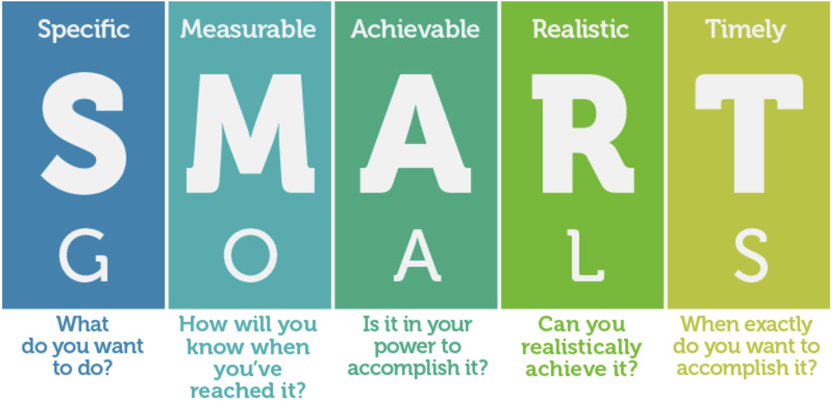
Speaking of Evaluation…

Slide 16
You’ve written. Now what?
Read, re-read, and have others read.
Leave time for edits…and more edits.
Compare the NOFO to your grant response. Is it:
Complete? Thorough?
Does it respect the limits?
Page count, font, format, etc.

Slide 17
Post-grant Writing Activities
Congratulations!
Celebrate!
Take a breather! (2.5 seconds)
Play the waiting game.

Slide 18
Award Activities
One of two things happened:
You didn’t get the grant:
If you plan to write more grants, learn why it wasn’t funded, when possible: get scores, read comments, ask what can be done differently (if appropriate).
Don’t take it personally!
You got the grant!
Celebrate! (2.5 seconds)
Open your application, pull your team together, and get busy!

Slide 19
Post-award
Activities
Work the grant activities. Use the application as your resource.
Got a problem? Try to work it out. Don’t wait!
Did you address this issue in your application?
Don’t pretend the issue isn’t there if it’s there.
If you have a solution to your barrier, implement it.
If that doesn’t work, seek an alternative solution. Has it been addressed by another organization? (Search the internet.)
Discuss the issue with your funder. (Reporting)
Schedule a meeting with the funder.

Slide 20
Tips
and
Tricks
Structure your narrative with the required sections.
Avoid using lots of color.
Intersperse graphs and tables. They are an attractive way to tell the story.
If you have lots of acronyms, use a definitions/explanations page.
Remember that your reviewers come from all walks of life. Don’t assume that they know what you are talking about.
Do not underestimate the cost of administration. Most federal grants allow a 10% de minimus.
Do NOT wait until the deadline.
Allow 2-3 hours per page.

Slide 21
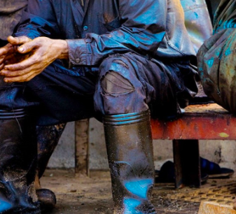
Hazards to Avoid
(and how to address them.)
Oops! I waited until the deadline and the grant portal or WiFi is down!
Oops! I have a question but the deadline for questions has passed!
Oops! I counted words instead of characters!
Oops! My application surpasses the page allowance!
Oops! I forgot to include an attachment!
Oops! I asked for a Letter of Support (LOS) but was refused!
Oops! I don’t have submission privileges and my submitter is on vacation!
Oops! I missed the submission deadline because I didn’t pay attention to the time zone!

Slide 22
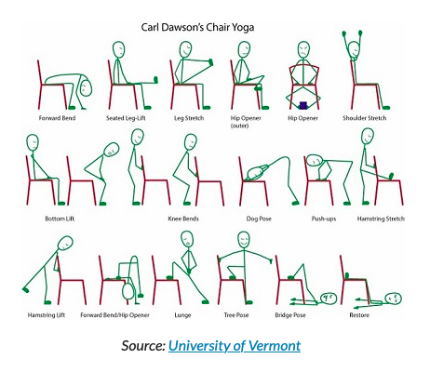
BREAK TIME!

Slide 23
Questions?

Slide 24
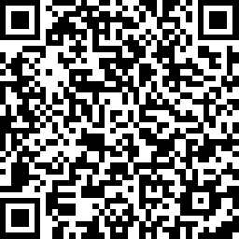
We want to hear from you!
https://www.surveymonkey.com/r/BSVCGV6
Notes:
Speaker: Please complete the post session survey to share your feedback. To access the survey, you can scan the QR code on this slide with the camera on your mobile phone! The survey should only take a minute or two to complete. Thank you!

Slide 25
Thank you for joining us!

