Slide 1
Environmental Health and Climate Change: Compounding Risks for Rural Communities
Notes:
Final Session Name: Environmental Health and Climate Change: Compounding Risks for Rural Communities
Time: 3:30-4:15 p.m.
Room: Grand IV

Slide 2
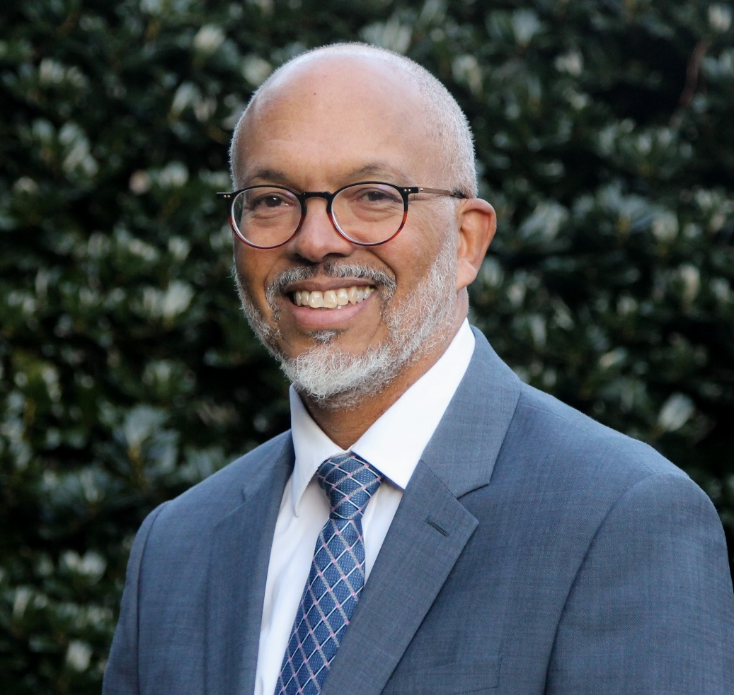
Speaker
E. Benjamin Money, Jr., MPH
  Senior Vice President of Population Health
  National Association of Community Health Centers (NACHC)

Slide 3
Environmental Health and Climate Change:
Compounding Risks for Rural Communities
A Presentation to:
The 2023 Louisiana Rural Health Workshop
June 20, 2023

Slide 5
Session Objectives
1
2
3
Understand the compounding risk of climate change and environmental health on rural communities.
Identify mitigation, adaptation, and resilience actions.
Gain resources and strategies to meet local risks and environmental issues.

Slide 6
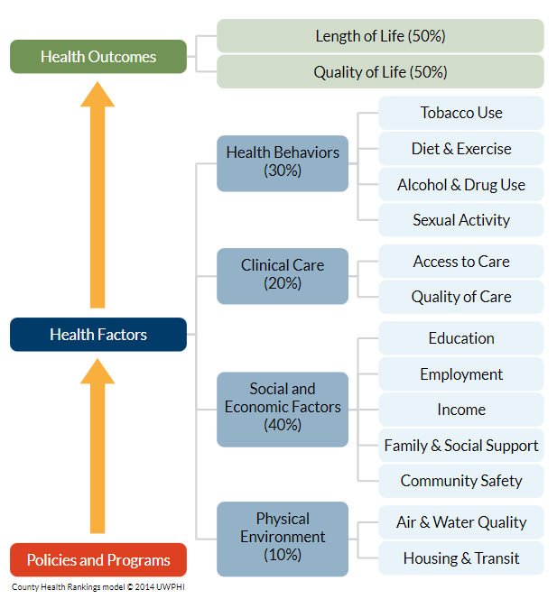
Drivers of Health
Achieving and maintaining health is influenced by factors external to clinical care.
Health Centers operate at the community level – the intersection of whole-person primary care and public health.
Notes:
The field is moving from terming the “D” in SDOH to “Drivers” because “Determinants” has a sense of finality.
PRAPARE team changed name to SDOH team in recognition of PRAPARE as a team within the context of broader SDOH topics and interventions

Slide 7
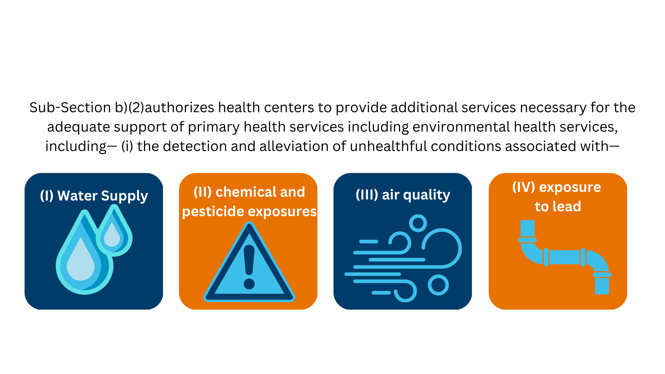
Section 330 of the Public Health Service Act (42 U.S.C. §254b)

Slide 8
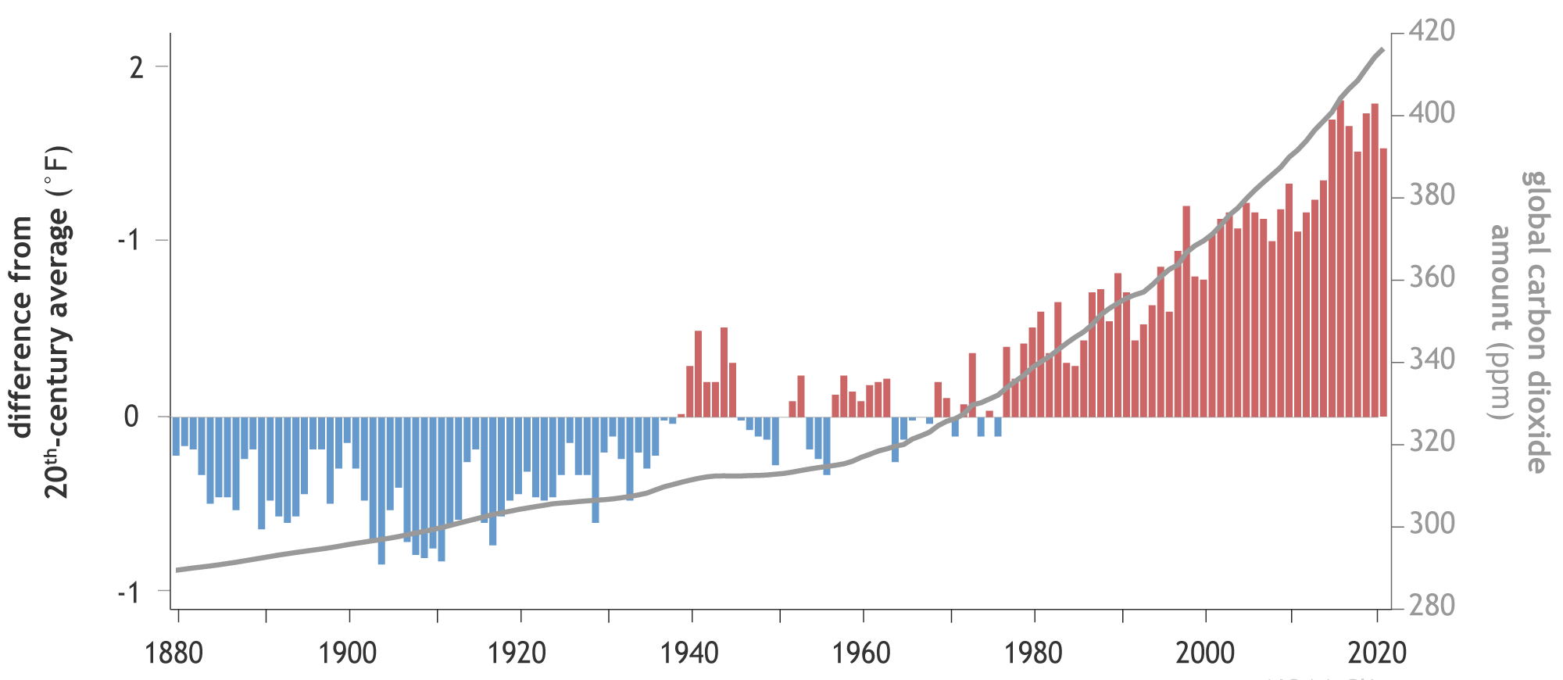
Global CO2 & Temperature Increases
Notes:
We’ve been steadily burning more and more fossil fuels over the years.
Right now, we’re burning 40-times the fossil fuels than a century ago, in 1920.
As the GREY LINE here shows in this graph from NOAA, this has increased the Carbon Dioxide in the atmosphere from pre-industrial levels of 280 ppm (parts per million) to a rapidly growing 420 ppm today.
All the carbon pollution thickens the atmosphere, traps warmth like a blanket, and increases planetary temperatures
The bar graph shows, we’ve increase average planetary temperatures by 3 degrees Fahrenheit over the same 100 years
And those temperatures continue to, and will continue to grow, until we stop the pollution causing the warming
And every tenth of a degree makes a big difference – more than a trillion dollars and millions of lives – as we’ll see later.
NOAA. Carbon Dioxide Trends. https://www.climate.gov/media/13840

Slide 9
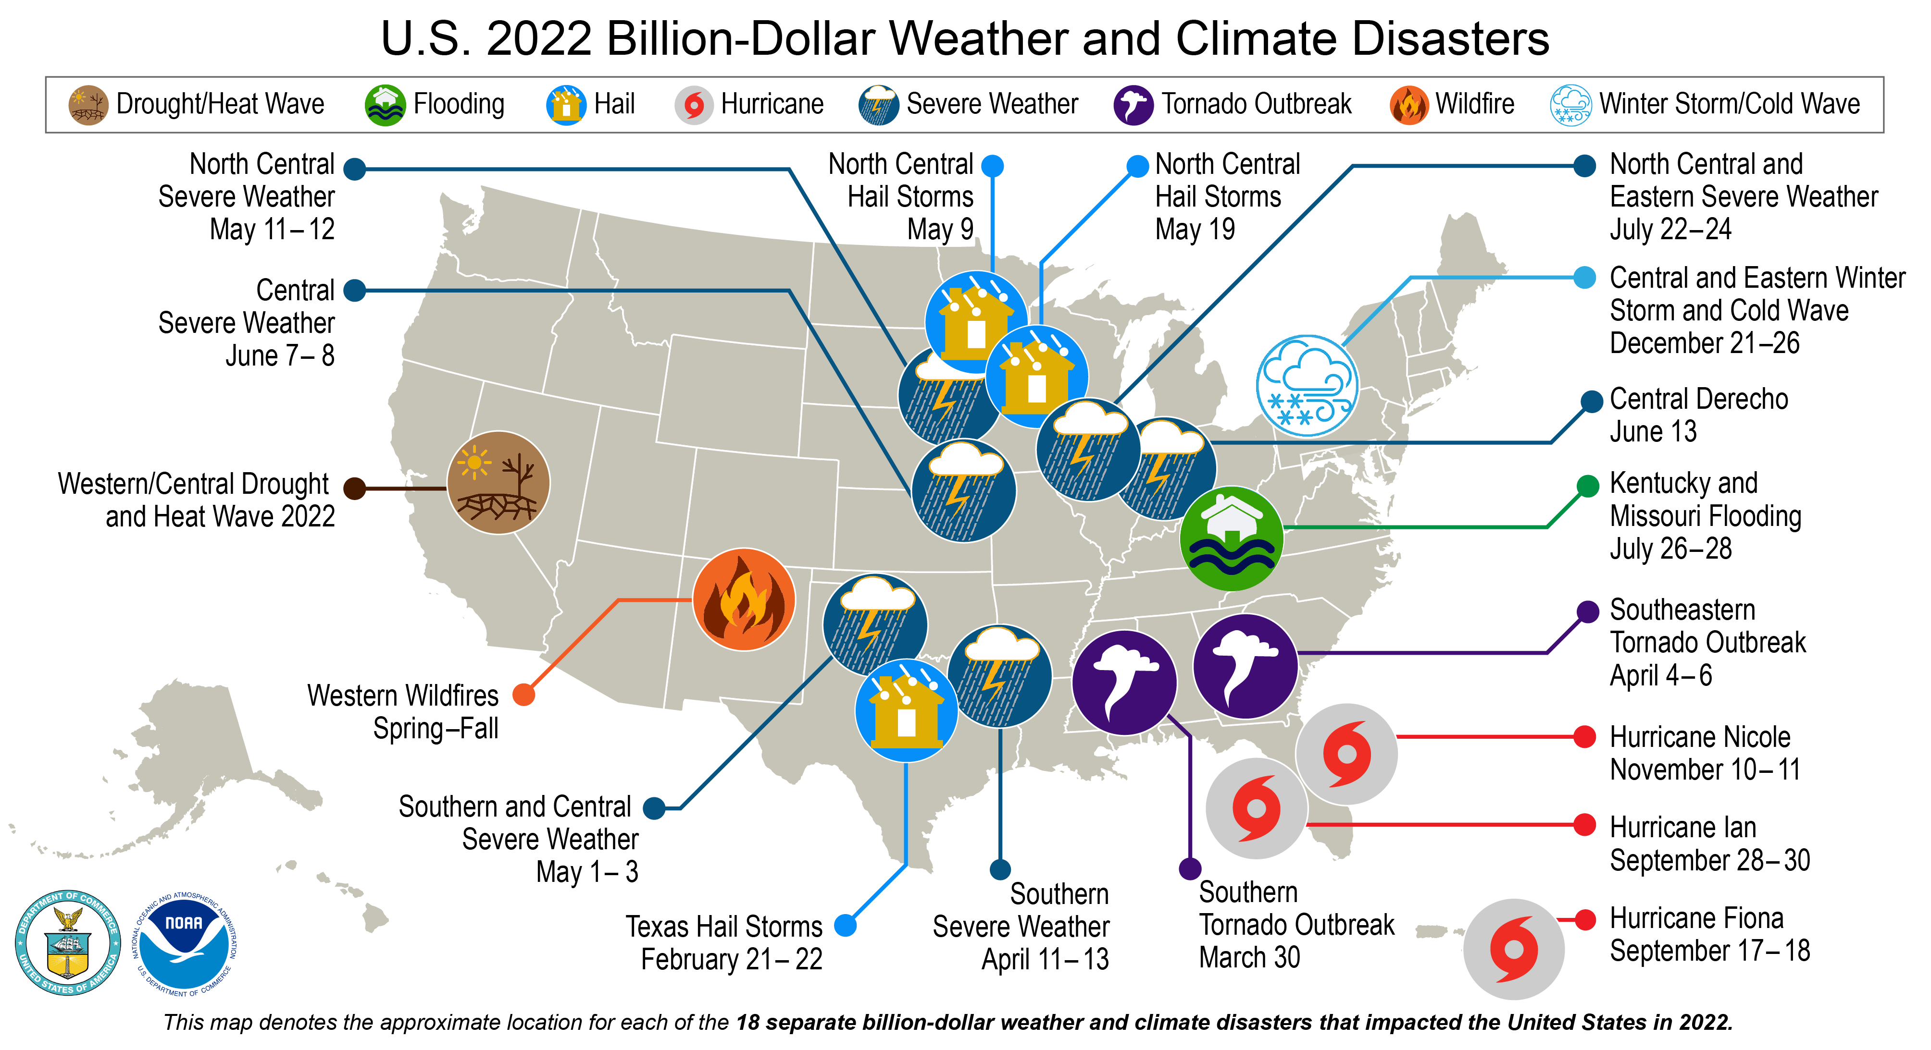

U.S. Billion-Dollar Disasters in 2022
Notes:
Those billion $ disasters are impacting every region of the US
The 1980–2022 annual average is 7.9 events (CPI-adjusted); but the annual average for the most recent 5 years (2018–2022) is 17.8 events (CPI-adjusted).
You can see the severe storms, hurricanes, and tornados in the south and Midwest. These are usually a day or two and average $2.3 billion in damages.
The little dots for the wildfires really understate the scale of these disasters
Wildfires out west are lasting weeks to month, burning forests and towns over millions of acres. They average $6.3 billion cost.
And the single dot for droughts in the southwest really understates the impacts there
The region is setting new records for duration and damages. The Colorado River and reservoirs are drying up
These have massive economic effects – from damage to property values to loss of infrastructure and jobs
Since 2000, every state in the nation has had at least one climate-related disaster. Some, like Texas, have had dozens.
https://www.climate.gov/news-features/blogs/beyond-data/2021-us-billion-dollar-weather-and-climate-disasters-historical
https://news.climate.columbia.edu/2021/10/04/attribution-science-linking-climate-change-to-extreme-weather/

Slide 10
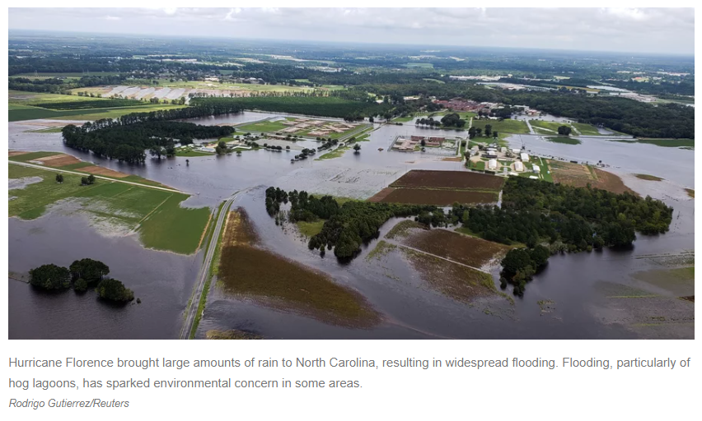
Climate Change Intensifies Environmental Health Events
Overflowing Hog Lagoons Raise Environmental Concerns In North Carolina
NPR/WUNC September 22, 2018 https://www.npr.org/2018/09/22/650698240/hurricane-s-aftermath-floods-hog-lagoons-in-north-carolina

Slide 11
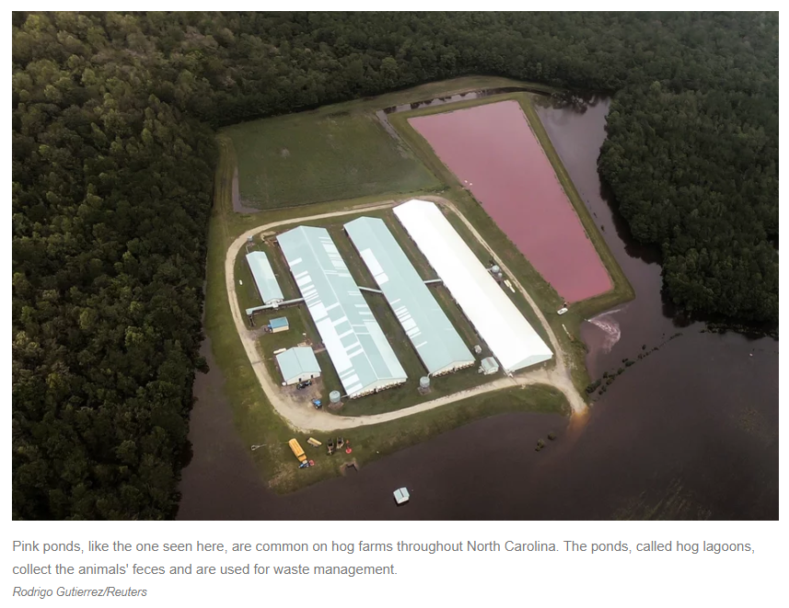
Climate Driven Environmental Disasters: Agricultural
Overflowing Hog Lagoons Raise Environmental Concerns In North Carolina
NPR/WUNC September 22, 2018 https://www.npr.org/2018/09/22/650698240/hurricane-s-aftermath-floods-hog-lagoons-in-north-carolina

Slide 12
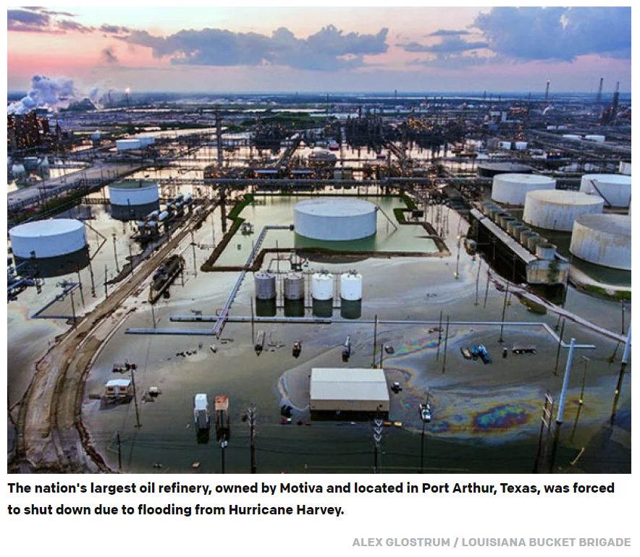
Climate Driven Environmental Disasters: Industrial
Hurricanes Irma and Harvey Cast Spotlight on Toxic Threats in Our Midst. Diane Carman, EarthJustice, Sept 12, 2017
https://earthjustice.org/blog/2017-september/hurricanes-irma-and-harvey-spotlight-trump-administration-unprepared-for-flooding-toxic-waste-sites

Slide 13
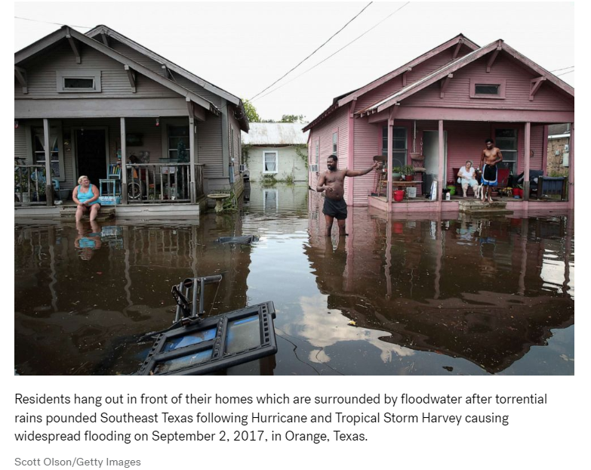
Climate Driven Environmental Disasters: Residential

Slide 14
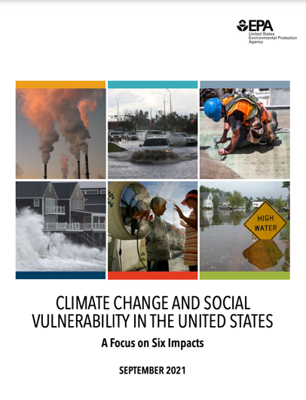
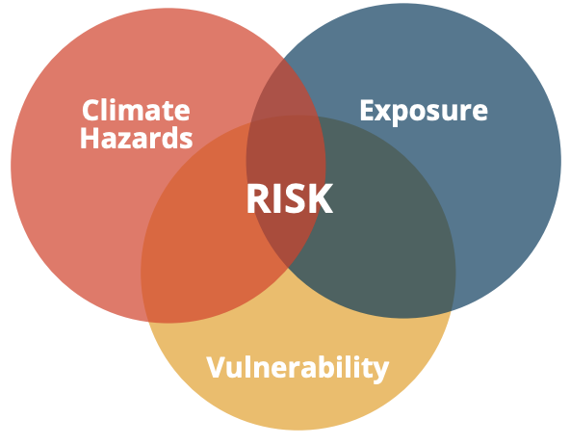
Climate Change Harms Some
More Than Others
Source: EPA. 2021. Climate Change and Social Vulnerability in the United States: A Focus on Six Impacts.
Notes:
Okey underlying concept is that climate change harms some more than others. This is something to keep at the forefront of our minds as we seek to understand the impacts, implications, and solutions to climate change.
Systems, laws, and policies rooted in racism and discrimination result in the disproportionate citing of polluting facilities in Black and Brown communities, and people experiencing poverty or with limited access to wealth are less able to respond to the impacts of climate change.
Just as one example of the substantial evidence on the topic, a new EPA report shows that the most severe harms from climate change fall disproportionately on underserved communities who are least able to prepare for, and recover from, heat waves, poor air quality, flooding, and other impacts.
EPA’s analysis indicates that communities of color are particularly vulnerable to the greatest impacts of climate change.
Something to consider is that those who bear the brunt of climate change are often those who contribute the least to the problem.
Sources:
EPA. 2021. Climate Change and Social Vulnerability in the United States: A Focus on Six Impacts. U.S. Environmental Protection Agency, EPA 430-R-21-003.

Slide 15
Notes:
Before I move into more specifics on climate and our health, I want to share this infographic from the U.S. Global Change Research Program which illustrates the social determinants of health framework applied to populations that can be disproportionately impacted by climate change.
While climate change affects all of us, communities experiencing poverty and under-resourced communities, communities of color, people with chronic disease or disability, children, and older adults are some of the most at-risk. Race and ethnicity, socioeconomic status, age, and education can actually impact a person or community’s ability to respond to environmental exposures — including climate change.
In this country, your zip code has a greater impact on your life expectancy than your genetic code.
Think about a community living near a polluting facility like a coal-burning power plant or an incinerator, more often than not a Black or Brown community. Pollution from that facility will be concentrated nearby, and as climate change worsens so does that air pollution.
Therefore, climate solutions present an opportunity to build health equity into our policies and practices at all levels. Promoting equitable climate and clean energy solutions will create a more healthy and prosperous future for everyone.
U.S. Department of Health and Human Services. Examples of populations at higher risk of exposure to adverse climate-related health threats. https://www.hhs.gov/climate-change-health-equity-environmental-justice/climate-change-health-equity/index.html

Slide 16


“For the first time in our nation’s history, the Federal Government has made it a goal that 40 percent of the overall benefits of certain Federal investments flow to disadvantaged communities that are marginalized, underserved, and overburdened by pollution.”
“The categories of investment are: climate change, clean energy and energy efficiency, clean transit, affordable and sustainable housing, training and workforce development, remediation and reduction of legacy pollution, and the development of critical clean water and wastewater infrastructure.”

Slide 17




The Problems of Rising Temperatures and Extreme Weather
Power Outages
  Power is essential for health
  The grid has become unreliable
  Outages don’t affect everyone equally
Rising Costs
  Increasing costs of power and healthcare delivery
  Health centers have increasingly tight budgets
  Impacts don’t affect everyone equally
Climate Change
Climate change is negatively affecting health
Health sector is a large contributor to GHG emissions
Impacts don’t affect everyone equally
From Collective Energy

Slide 18

Power shutoffs: populations at risk
Power outages can be life-threatening for medically vulnerable
Critical facilities don’t always have a ready backup power system
Causes of power shutoffs
In a survey conducted by Direct Relief, only 44% of California health clinics surveyed had backup power
Clinics lost temperature-regulated vaccines and medications
Lost patient revenue
Inability to provide healthcare
Heat Waves
Fires
High Wind
Hurricanes
Tornadoes
Cold Snaps
Utility, Grid, Transmission Line Failure
Demand
  2 million residents lost power during last year’s California's PSPS
  180,000 are registered as electricity-dependent for medical devices
  Gas and diesel generators pose problems
Notes:
The California public safety shutoffs really exemplify these issues. About 33,000 of the PG&E customers who lost power were enrolled in the company’s registry program for people who rely on medical devices that require electricity. While the company opened a number of resource centers where people could charge devices, among other services, many were unaware, couldn’t travel to, or opted to not to utilize the centers. Instead, many looked to local critical facilities, with mixed results. One survey conducted by Direct Relief, an international humanitarian aid organization, estimated that only 44 percent of rural health clinics in California had access to any sort of backup power resource. The rest closed when the outages hit. Residents were forced to seek out distant care and one clinic alone lost hundreds of thousands of dollars worth of vaccines and medications due to lack of refrigeration.
For residents that could access backup power, gas generators are the traditional go-to. Unfortunately, studies show that carbon monoxide spikes occur after natural disasters as people improperly operate gas generators. Especially for medically vulnerable individuals that are frail or have mobility limitations, operating a diesel generator, as well as fueling one, can be especially difficult. For lower-income residents, the cost of purchasing fuel can be burdensome as well.

Slide 19
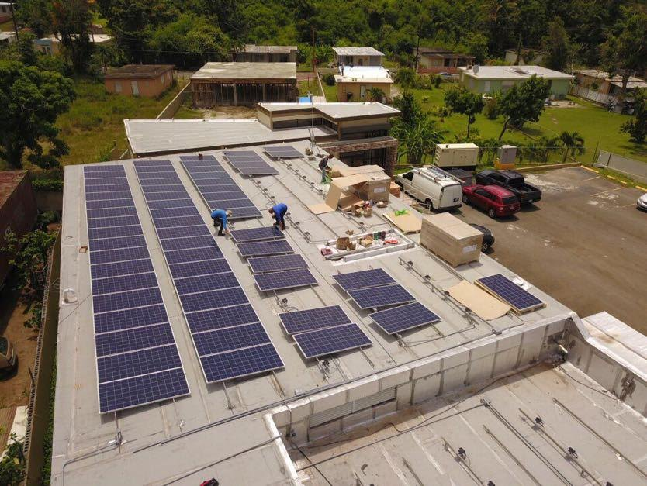

Case Example: Puerto Rico
Hurricane Maria devastated much of the infrastructure in Puerto Rico and heavily damaged the already fragile electrical grid.
Longest blackout in US History
80% of the island's transmission lines were damaged, leaving communities without access to essential facilities including medical clinics, fire stations, schools, water pumps for months.
Since Hurricane Maria, hundreds of solar and storage projects have been implemented in Puerto Rico

Slide 20

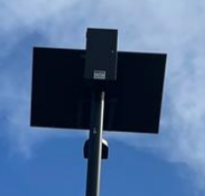


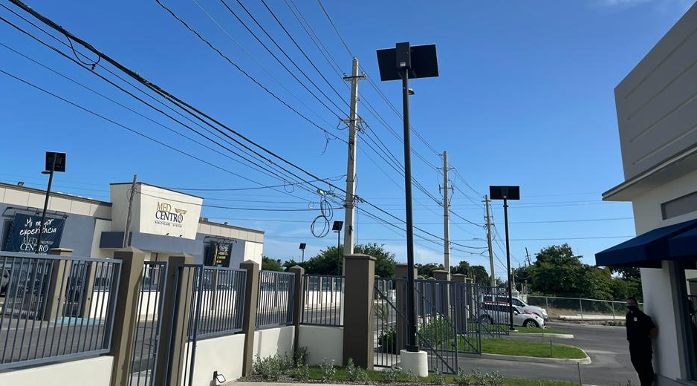



Solar Project Profile: MedCentro
Commitment to 100% solar operation, including private investment.
Acquisition of hybrid mobile units that operate 100% off of solar-attained energy.
Hurricane-force enduring solar lighting infrastructure around facilities and surrounding communities.
Prioritization of IT systems and private servers connected to solar. Projected to run Telemedicine facility 100% with solar power.
Notes:
Redundancy with generators of at least 15 while running 24/7
Seamless continuity of operations
Wiring for internet and electric for their buildings is buried and not susceptible to many damages that the power lines often suffer like poor upkeep, trees falling, maintenance of power transformers
Interest in Pursuing leed and other certifications

Slide 21

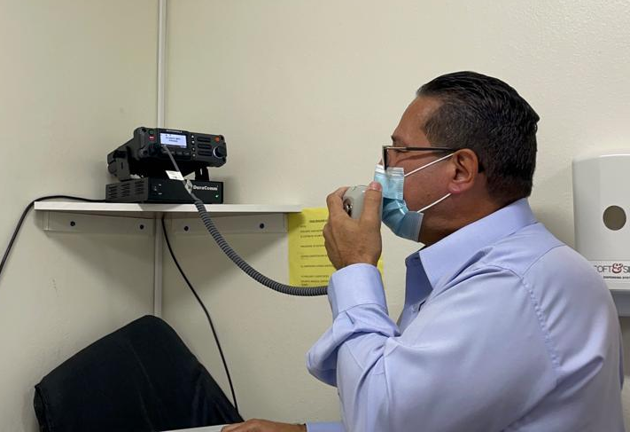

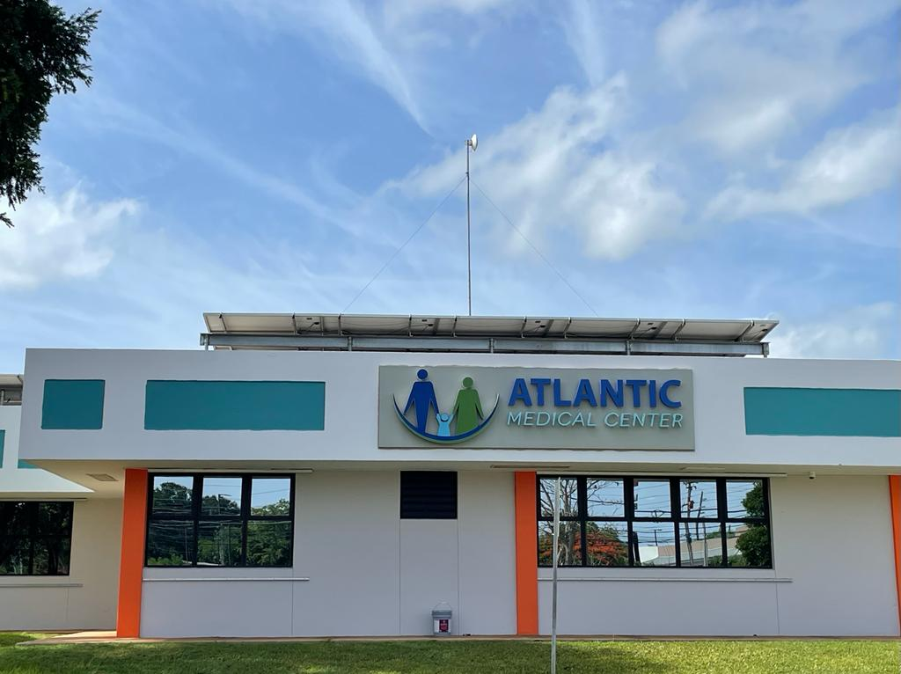



Solar Project Profile: Atlantic Medical Center
An estimated $5,000 in savings per month on power utility
Fine tuning engineering for automated transferring of power-source
Expanding use of solar energy dependant on more battery storage.
Current use in main clinic. Prioritizing of IT Systems and cold-chain
Notes:
Redundancy with generators of at least 15 while running 24/7
Seamless continuity of operations
Wiring for internet and electric for their buildings is buried and not susceptible to many damages that the power lines often suffer like poor upkeep, trees falling, maintenance of power transformers
Interest in Pursuing leed and other certifications

Slide 22
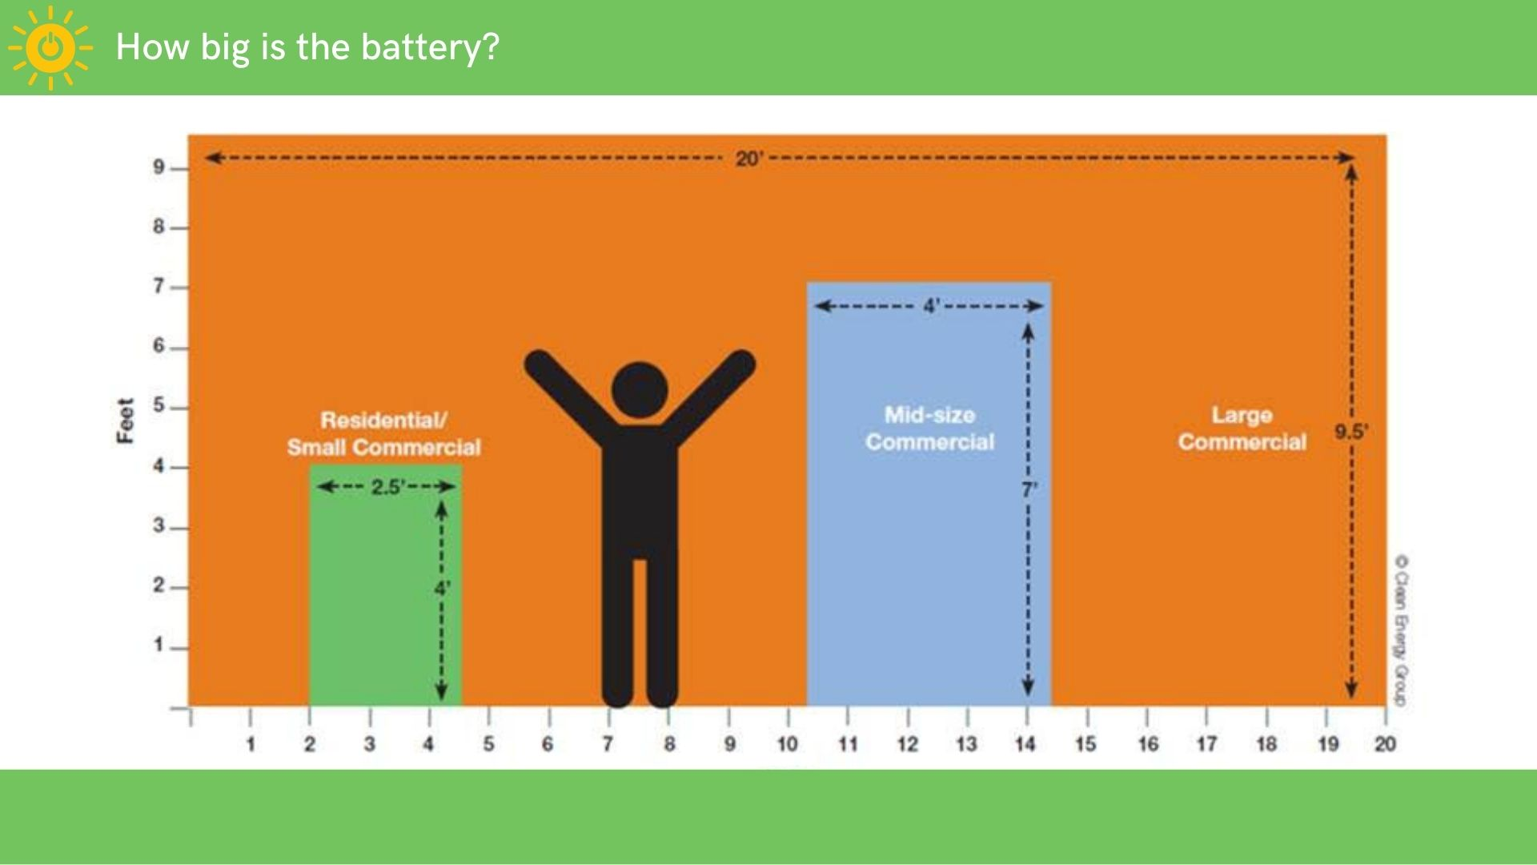
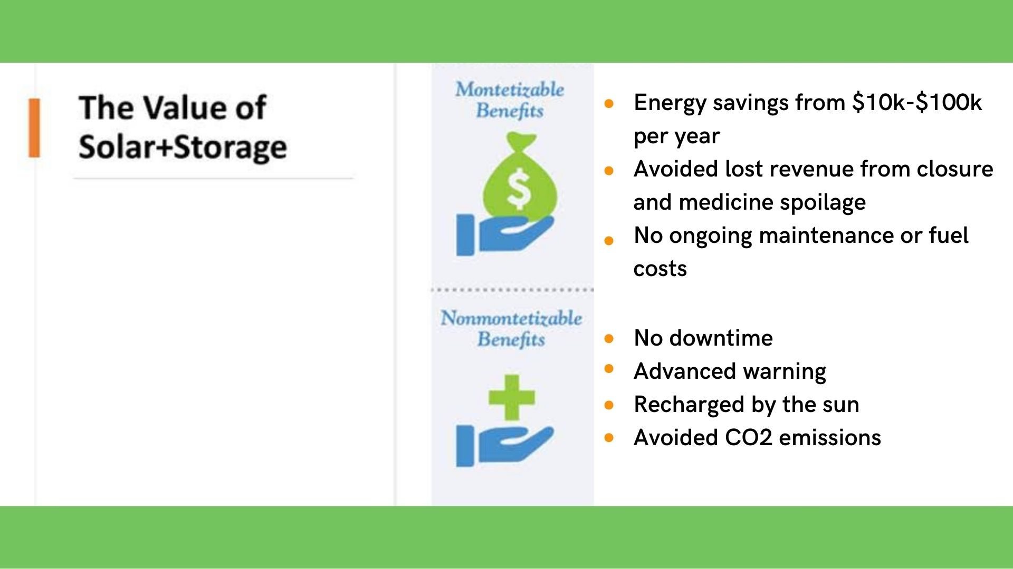
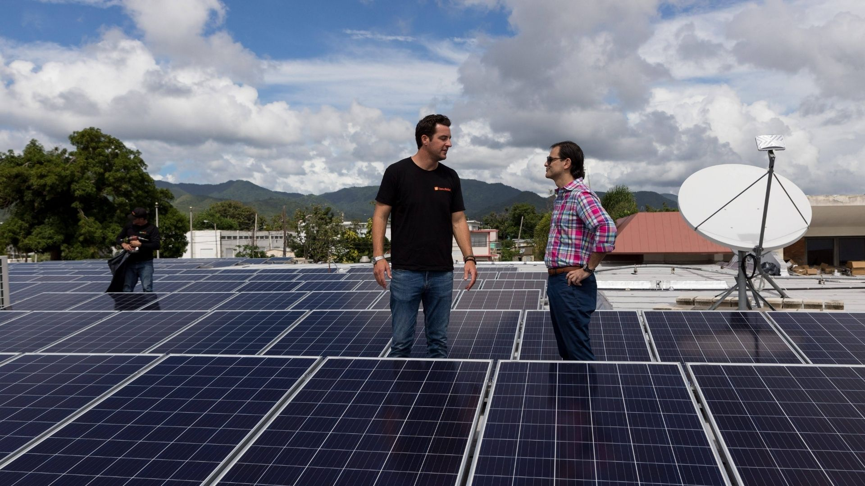
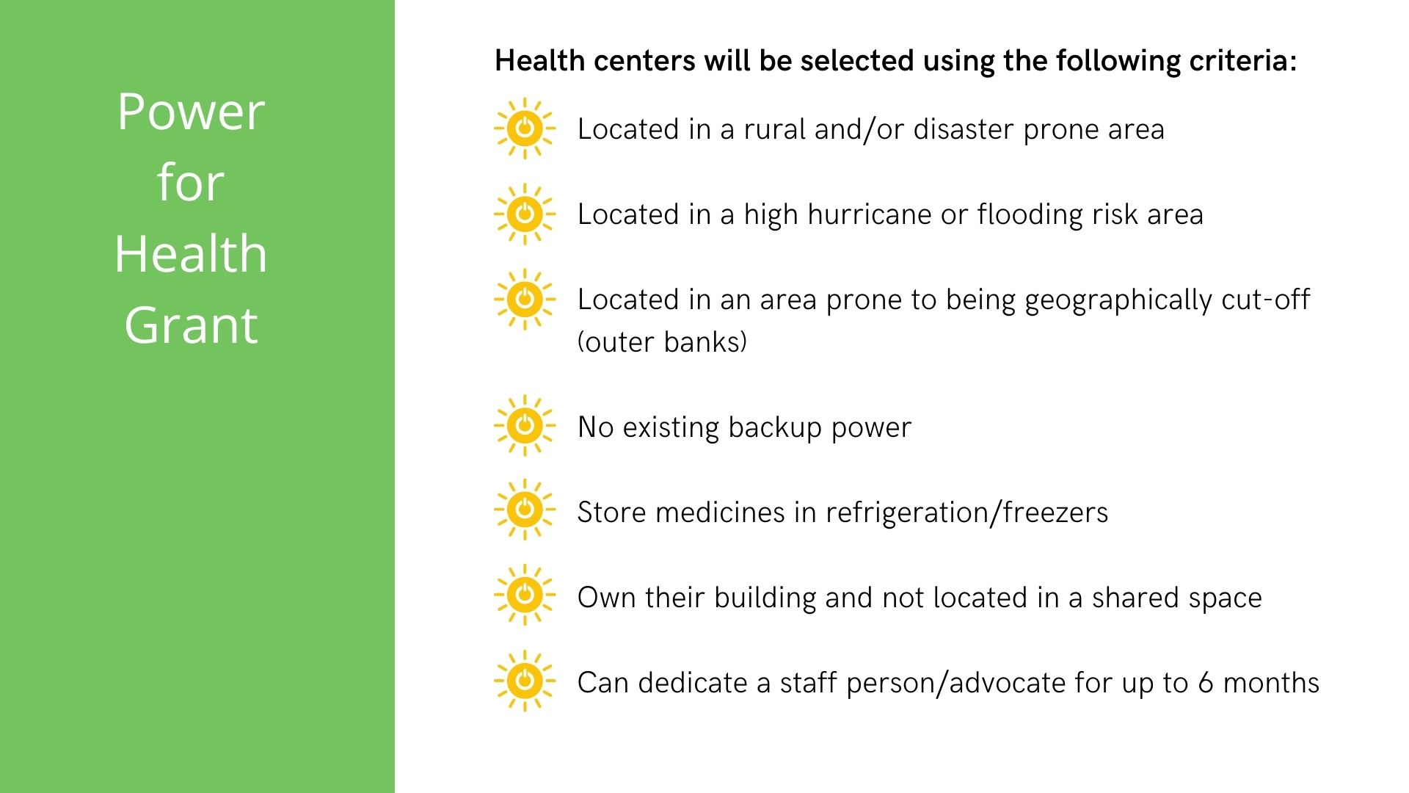
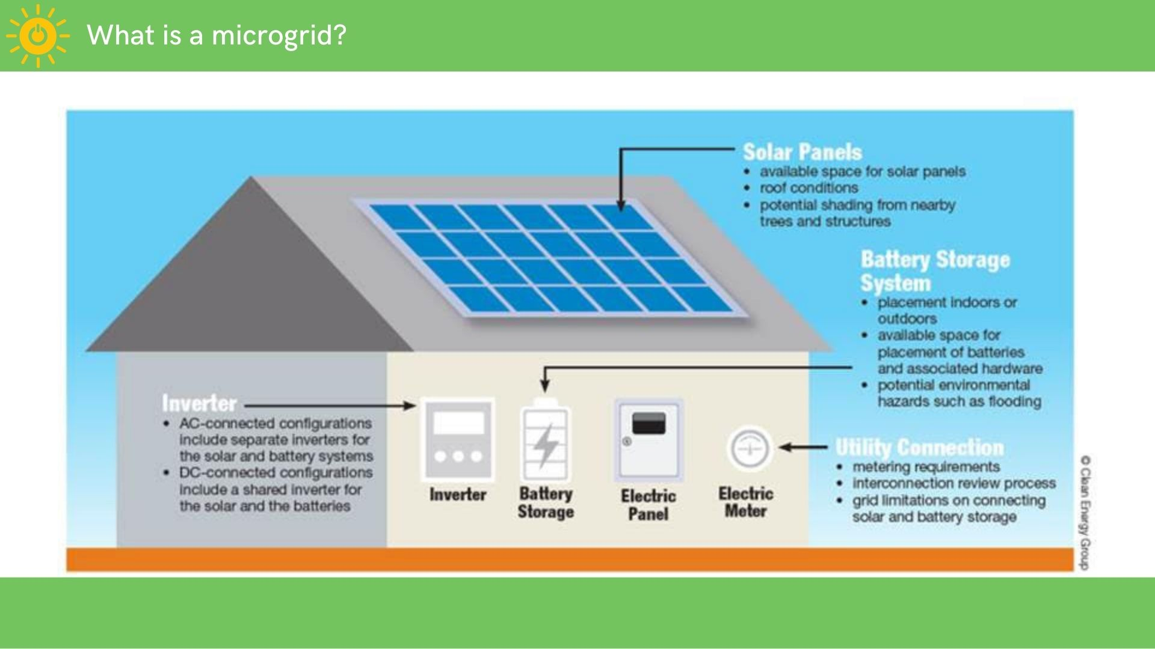

Slide 23
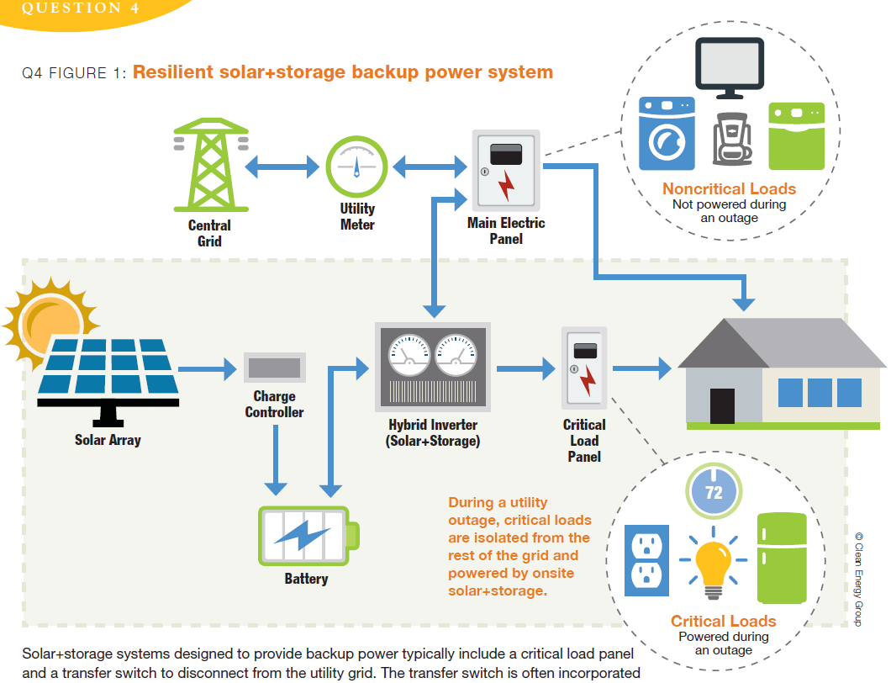

Slide 24
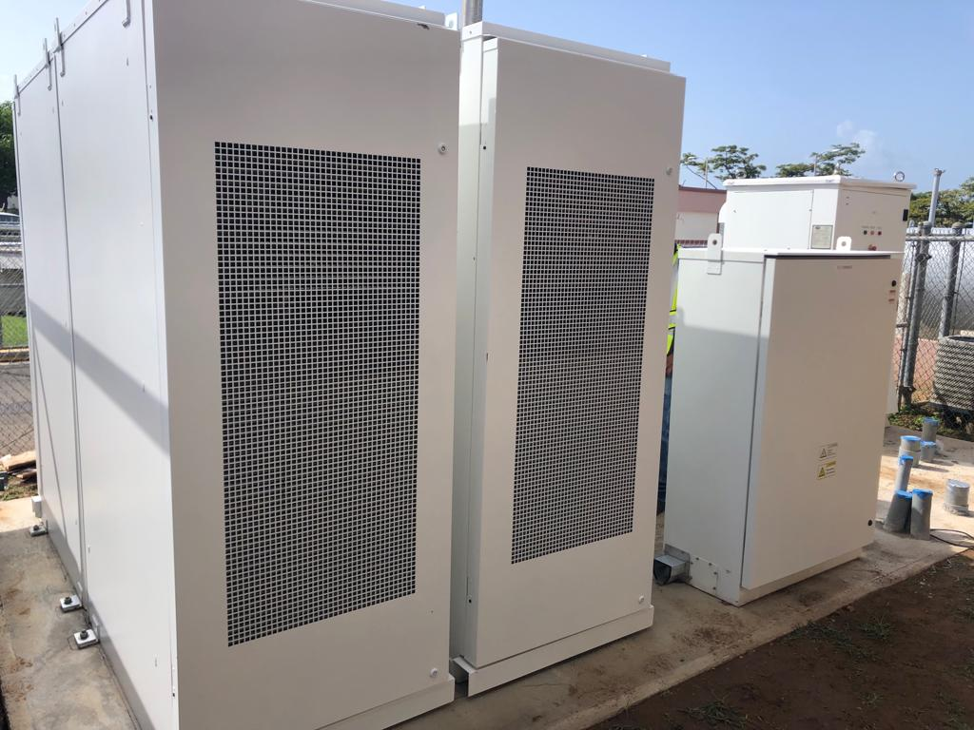
Battery Storage

Slide 25
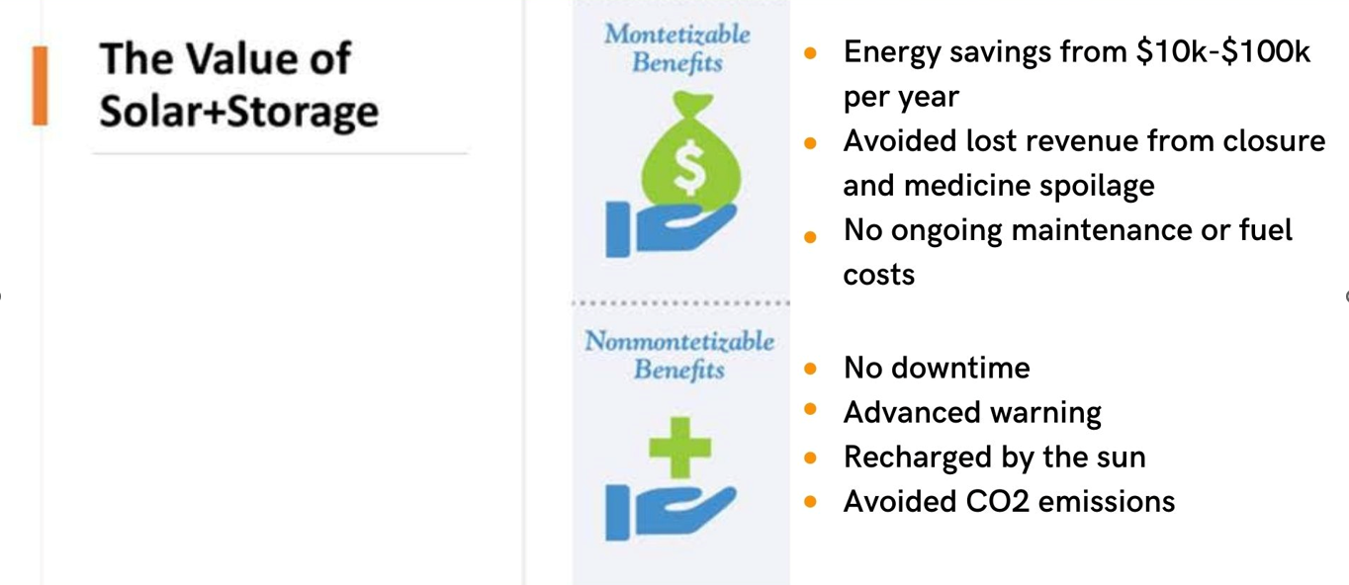

Slide 26
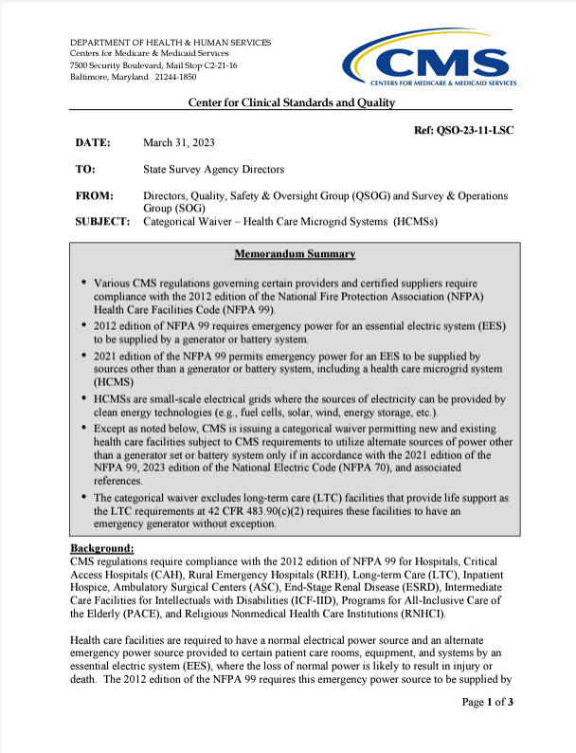
CMS Rules Updated to Permit Solar Microgrids
CMS issued a categorical waiver on March 31, 2023 permitting new and existing health care facilities subject to CMS requirements (except LTC) to utilize alternate sources of power other than a generator set or battery system only if in accordance with the 2021 edition of the National Fire Protection Association (NFPA) Health Care Facilities Code (NFPA 99).
2021 edition of the NFPA 99 permits emergency power for an EES to be supplied by sources other than a generator or battery system, including a health care microgrid system (HCMS)

Slide 27
Size+Cost=Savings
Solar + storage lowers the institutions’ regular utility costs year-round
Facility Size | Solar+Storage Size | Solar+Storage Cost | Electricity Savings Per Year* | Electricity Savings Over 30 Years
2,000-4,999sq ft | 30kw/65kwh | $150,000 | $10,000 | $300,000
5,000-9,999sq ft | 75kw/150kwh | $375,000 | $20,000 | $600,000
10,000-19,999sqft | 125kw/250kwh | $625,000 | $30,000 | $900,000
20,000+sq ft | 250kw/500kwh | $1.1M | $50,000 | $1.5M
*Amounts are estimates as utility costs vary greatly across the country

Slide 28




https://chargepartnership.org/

Slide 29
Value and Co-benefits of Solar Microgrids
Cost Savings
Mitigation
Resilience

Slide 30
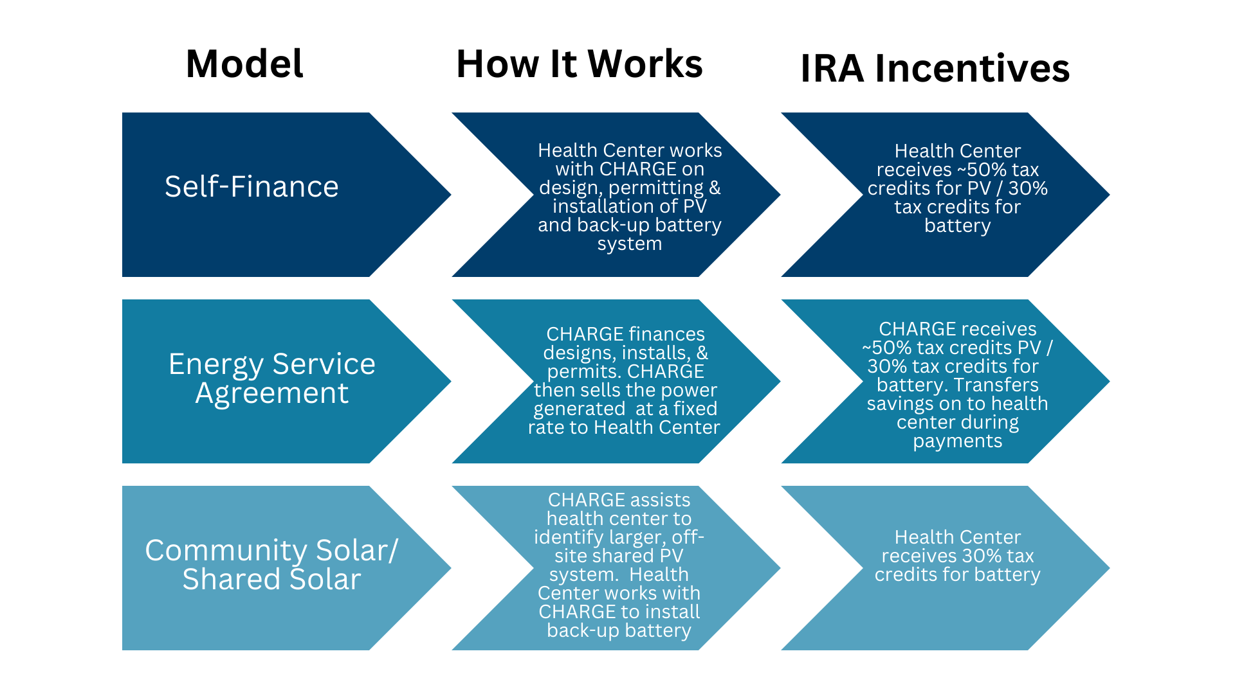
Notes:
https://www.cleanegroup.org/what-nonprofits-need-to-know-about-the-investment-tax-credit/

Slide 31

Leveraging the Inflation Reduction Act of 2022 (IRA)
The Inflation Reduction Act of 2022 (IRA) updated and expanded the Investment Tax Credit (ITC) for solar and battery storage resilient power projects.
  1) Nonprofits with no tax liability can now apply for direct pay reimbursement equal to the value of the tax credit
  2) Storage-only projects are now eligible for the ITC.
  3) The ITC now includes several ‘bonus credits’, which can significantly increase savings for projects serving low-income and underserved communities.

Slide 32
Investment Tax Credit (ITC) for solar, wind, and storage projects
The ITC was increased to 30% baseline credit for projects installed before 2033. Projects may be eligible for up to six bonus credits that could raise the value of the ITC up to 70% of the cost of the project’s installation.
The ITC includes six different bonus credits that projects may apply for.
Four of those credits are housed within the Low-Income Communities Bonus Credit Program.
Currently, projects can only apply for one of the four bonus credits within the Low-Income Communities Bonus Credit Program.
This means a project could either receive a 10% or 20% bonus credit, depending on their eligibility.

Slide 33
Low-Income Communities Bonus Credit Program
The four bonus credits within the Low-Income Communities Bonus Credit Program are:
10% bonus for projects located in a low-income community
10% bonus for projects located on Tribal Land
20% bonus for projects when the facility is part of a qualified low-income residential project
20% bonus for projects when the facility is part of a qualified low-income economic benefit project

Slide 34
Stackable Bonus Credits
The ITC also includes two additional 10% credits, which are stackable. Projects who are eligible can apply for both bonus credits, in addition to the 30% baseline credit and one of the bonus credits within the Low-Income Communities Bonus Credit Program. The IRS has not released detailed guidance about how these credits will be implemented.
The two stackable bonus credits are:
10% bonus for projects located in an “energy community”
10% bonus for projects that meet domestic manufacturing requirements

Slide 35
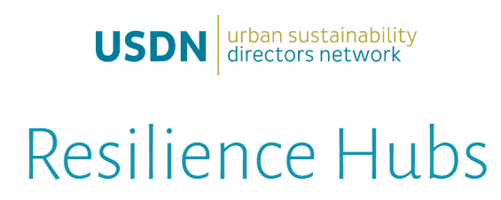
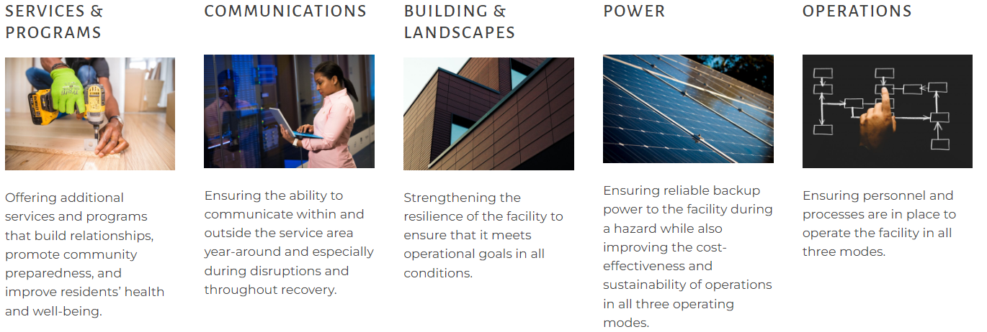
5 Foundational Areas

Slide 36
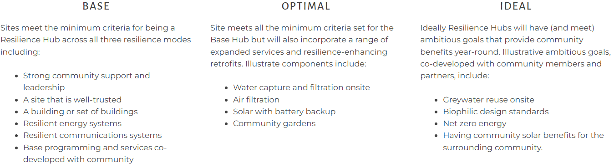
3 Options for Resilience Hubs

Slide 37
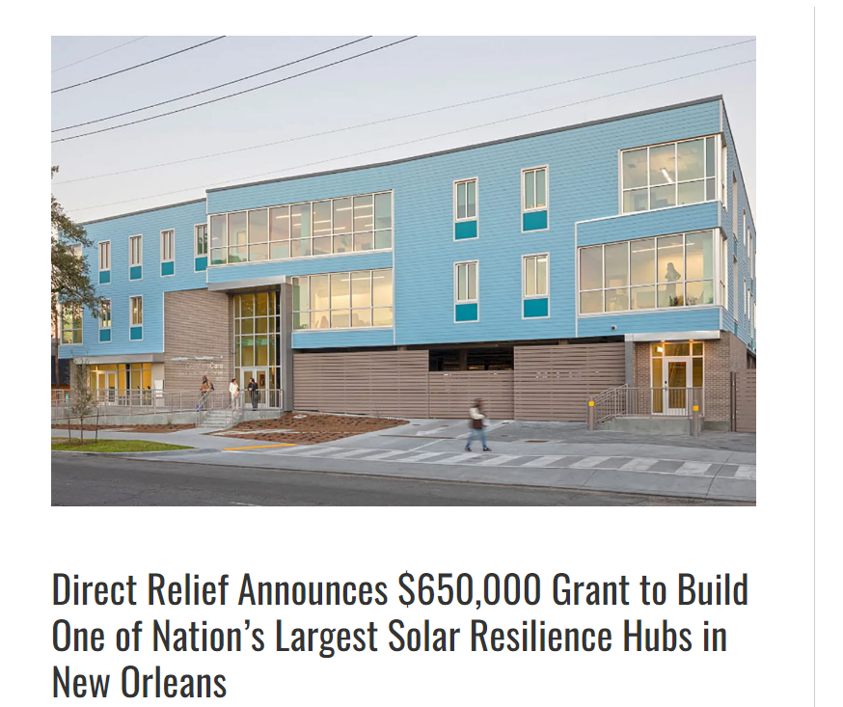

Health Center Resilience Hub Example:
CRESCENTCARE
NEW ORLEANS, LOUISIANA
In the aftermath of Hurricane Ida last August, 19 New Orleans residents died from excessive heat, lack of oxygen or carbon monoxide poisoning
Community Light House Initiative-creates a communitywide network of nonprofit "resilience hubs" each powered by commercial-scale solar systems with backup battery capacity.
Notes:
Both Internal and External

Slide 38

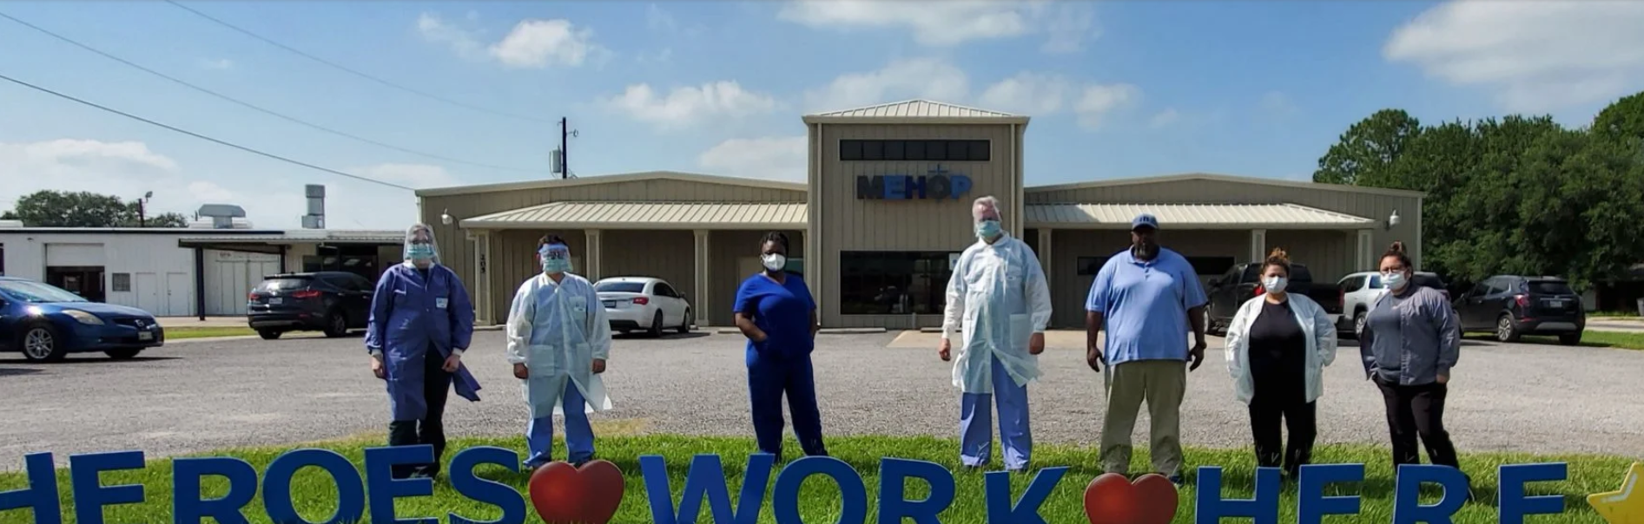
Harvard Chan C-CHANGE runs Climate MD, a program focused on:
Working with community health clinics
Demonstrating climate impacts to health care delivery in medical journals
Preparing medical leaders on climate and health
Changing the national media narrative on climate change
Communicating directly with patients
Building Patient-Centered Climate Resilient Clinics
Resources to Build Climate Resilience in Frontline Clinics
Interventions to Protect High Risk Patients
Alert System for Climate-Driven Health Threats
Educational Opportunities for Clinics and Health Care Providers

Slide 39
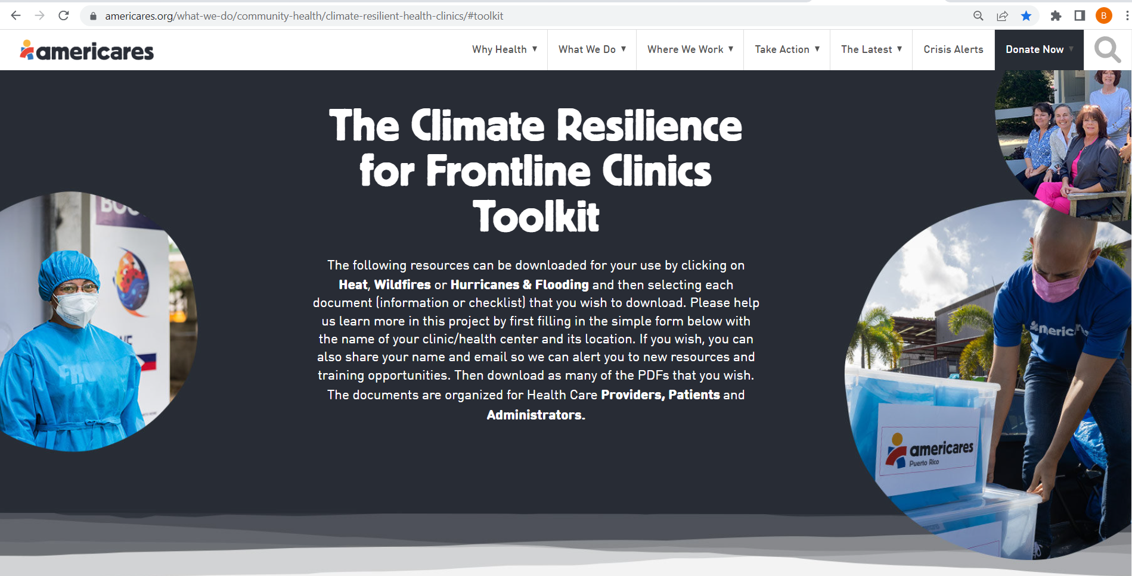

Slide 40
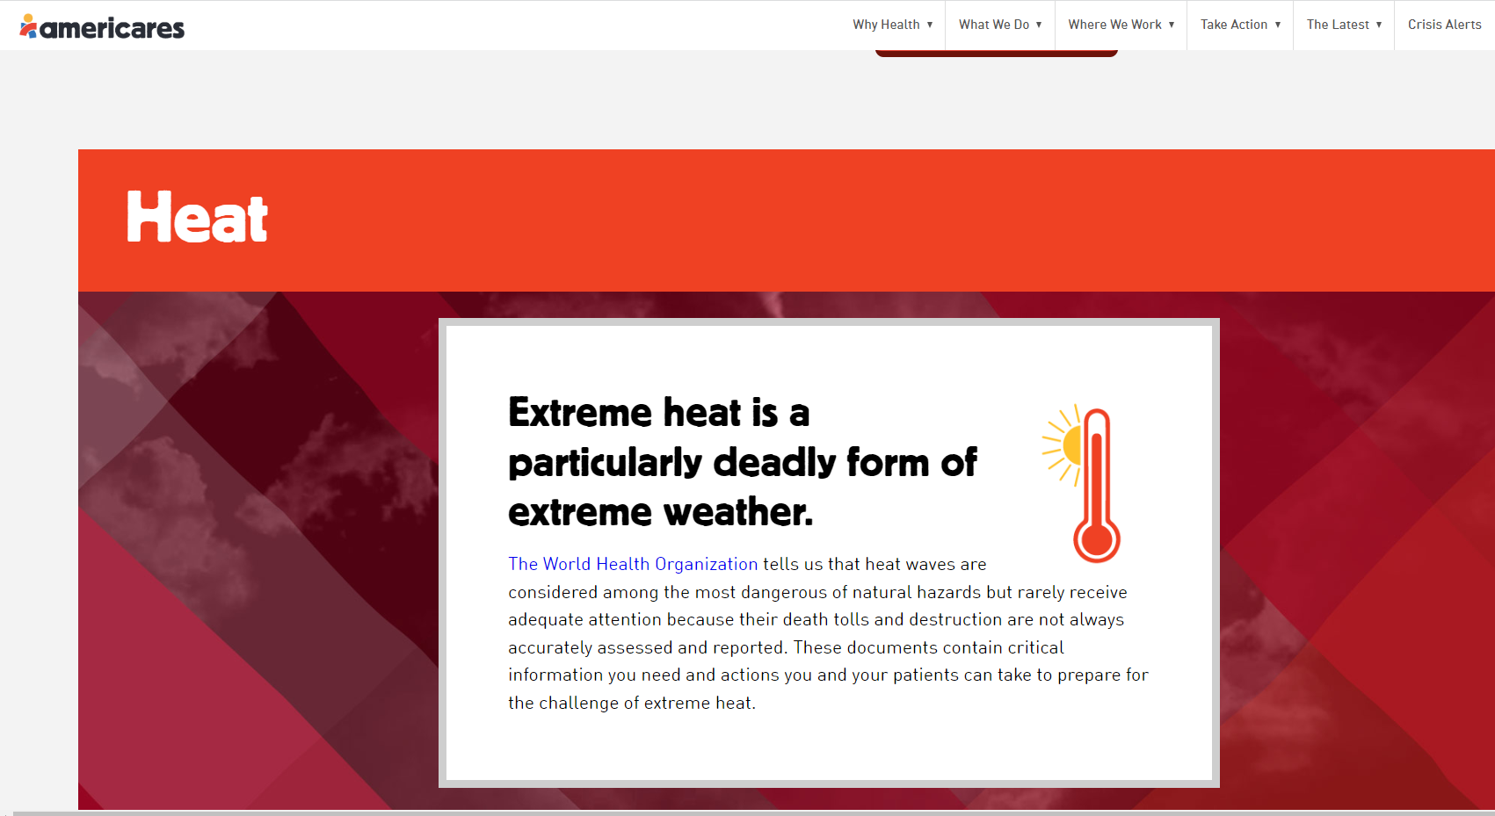

Slide 41
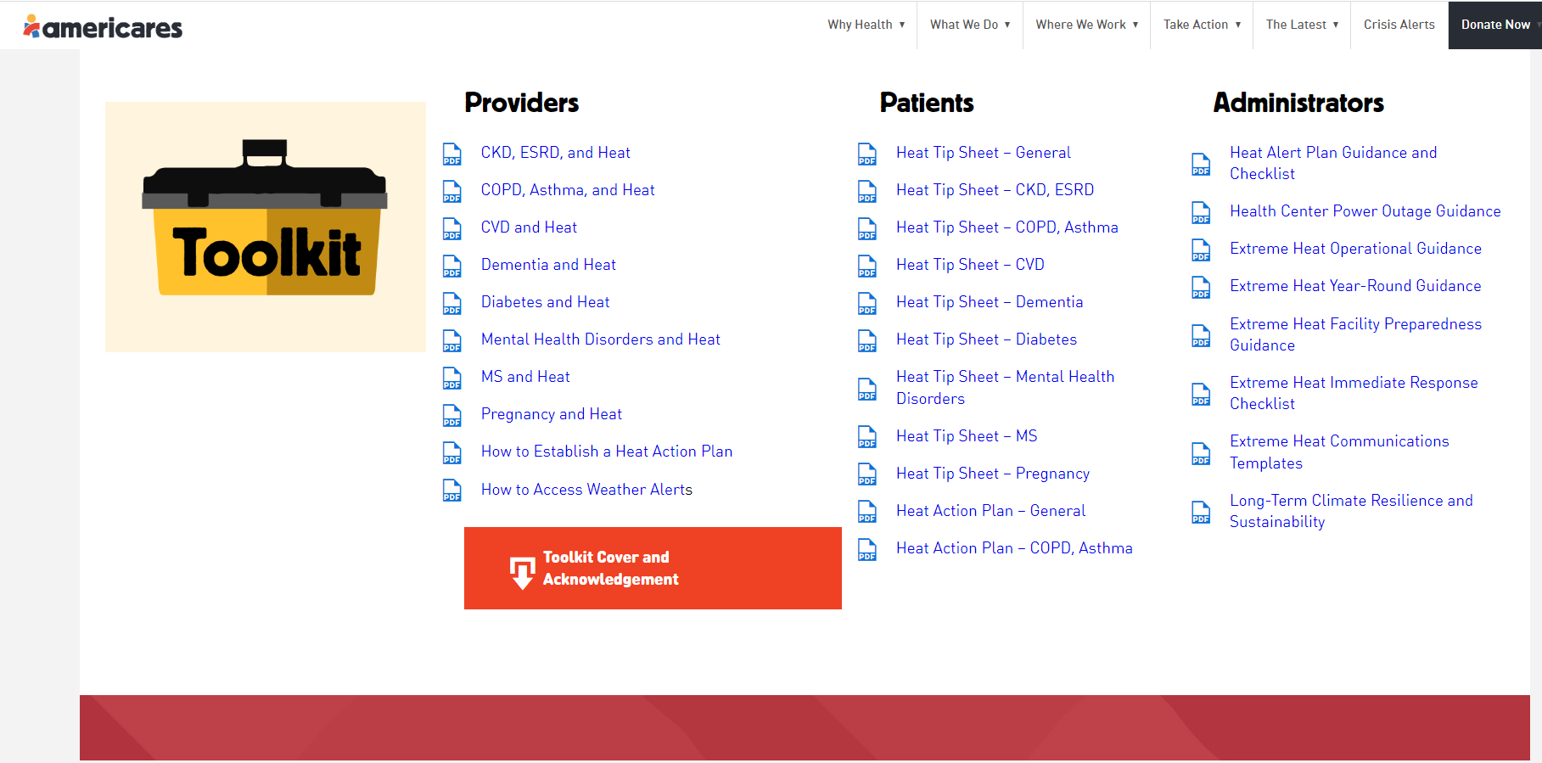

Slide 42
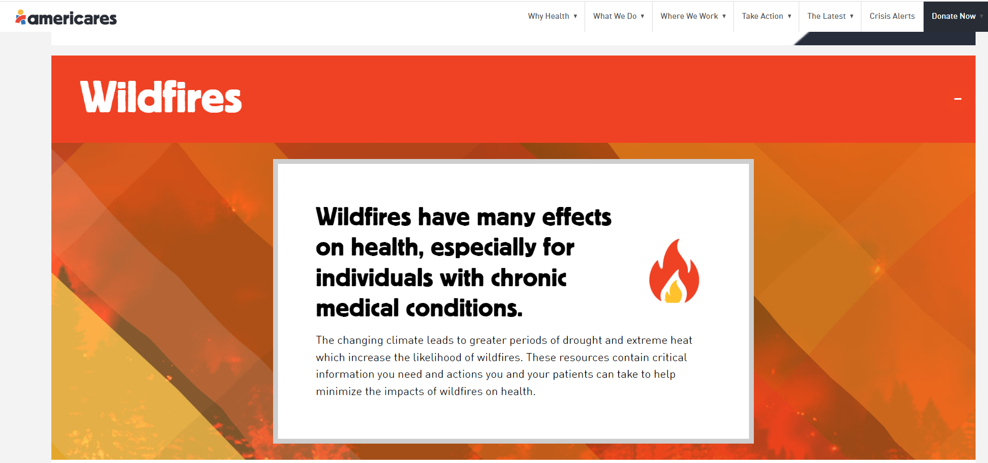

Slide 43
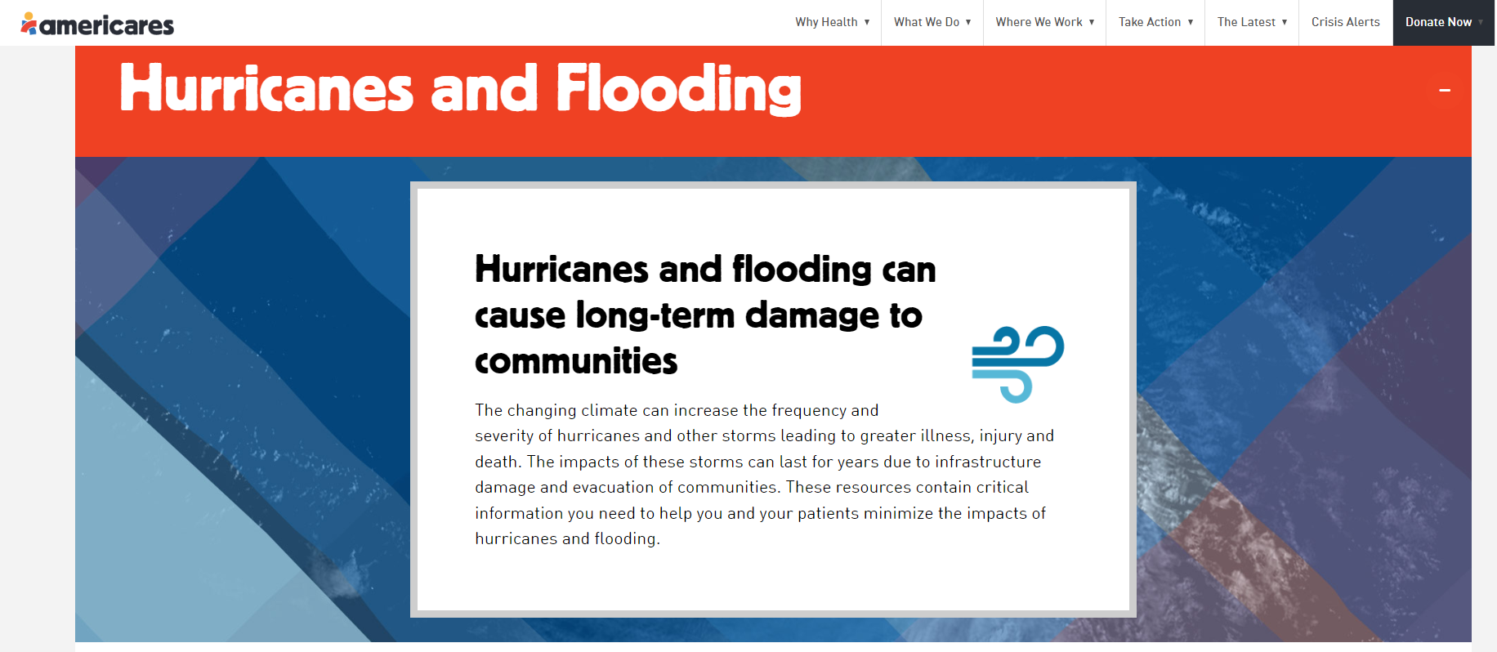

Slide 44
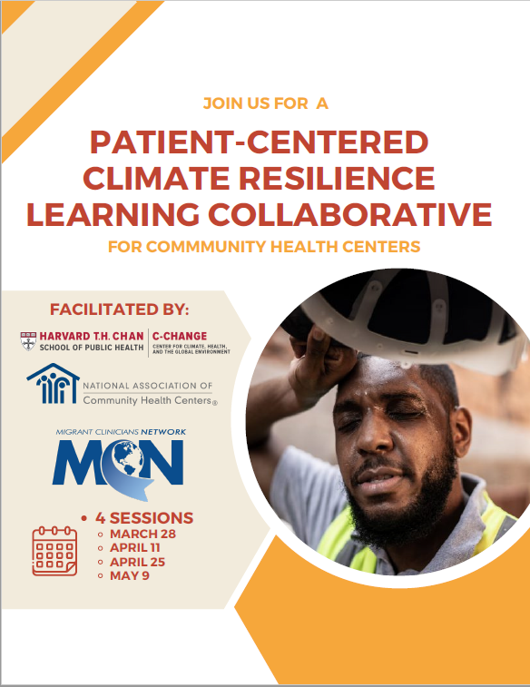
Underway:
NTTAP Funded Learning Collaborative
Registrant Information:
77 individual participants
41 different organizations
  27 health centers
  11 PCAs
  3 other organizations
Notes:
The participants shared their learning interests as follows:
Understanding "What is patient centered climate resilience?"
Understanding of "climate readiness"
Foundational understanding of how patients are impacted by a changing climate; especially for populations that have been systemically marginalized
Identifying patients vulnerable to climate change/screening
Action plans for mitigating/adapting/building resilience to climate change impacts and how to effectively implement such plans
Specific interest for certain climate/weather events
A few of the participants have been directly affected by wildfires and would like to learn more about the health center role in these situations
Extreme heat (especially for farmworker populations)
Hurricanes/preparedness
Flooding events
Crisis leadership/communication
With communication being both internal and external to the health center
Engaging with state and local agencies/building partnerships on climate issues
Budgeting considerations for this type of work

Slide 45
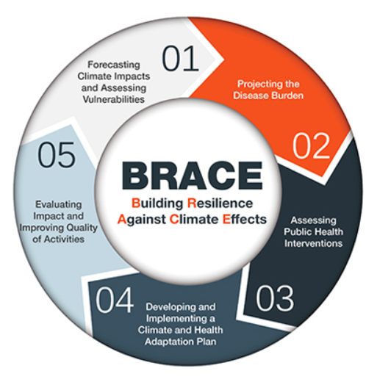
CDC’s Building Resilience Against Climate Effects (BRACE) Framework
The Building Resilience Against Climate Effects (BRACE) framework is a five-step process that allows health officials to develop strategies and programs to help communities prepare for the health effects of climate change.

Slide 46
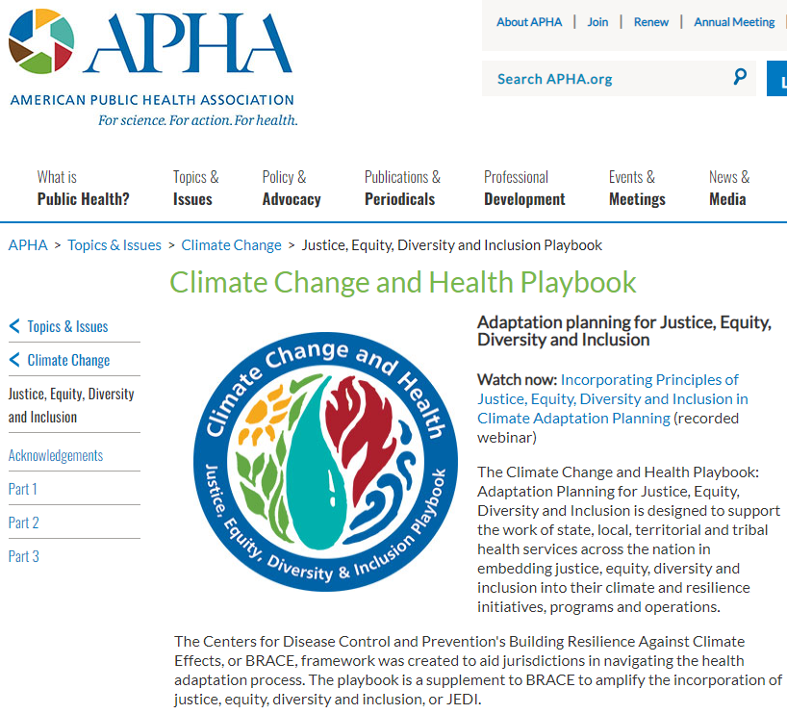

Slide 47

Rationale and Purpose
Calls for health department engagement in climate change solutions and adaptation have increased. Yet these departments, especially at the local level, vary in their resources and expertise related to climate change. To accelerate climate action in the communities they serve, health departments must collaborate with partners
in many sectors. This is especially true about partnering with organizations that represent communities disproportionately affected by climate impacts. The BRACE framework revision will thus be grounded in a process that equally reflects the perspectives of frontline organizations, technical experts in climate and health, and health departments that wish to address the climate and health crisis. To meet this need, the BRACE framework revision will be guided by an Expert Panel whose members have wide-ranging, in-depth expertise and commitment to innovation in equity, climate and health adaptation and mitigation, and implementation.

Slide 48

PCA Emergency Management Advisory Coalition
Convenes monthly virtual and annual in-person meetings
Provides field intelligence and communications
Partners at the local, state, national and federal levels, as well as with relief organizations
Leverages resources and acts a subject matter experts on emergency management for CHCs
Provides opportunities for training and technical assistance
Supports the onboarding of new emergency management staff at CHCs, PCAs, HCCNs and NTTAPs
Supports network growth and professional development of members
Mission: To support community health centers in fulfillment of their daily commitment to patients, their families, visitors and staff; missions to provide high quality, comprehensive and affordable health care that is coordinated, culturally and linguistically competent, and community directed for all medically underserved populations; and goal to provide education on policy and regulatory impacts on community health centers.

Slide 49
PCA Emergency Management Advisory Coalition
114 individual members:
97 Primary Care Associations (PCAs)
14 National Training & Technical Assistance Partners (NTTAPs)
2 Health Center Controlled Networks (HCCNs)
4 regional PCAs
All 50 states and most US territories represented
Vision: To coordinate and provide support to community health centers in preparing for, responding to, and recovering from emergencies that affect the delivery of healthcare and/or its infrastructure in any or all states and regions. It is our goal to speak with one voice to augment the awareness of the position of community health centers, their patients and our primary care association network.

Slide 50
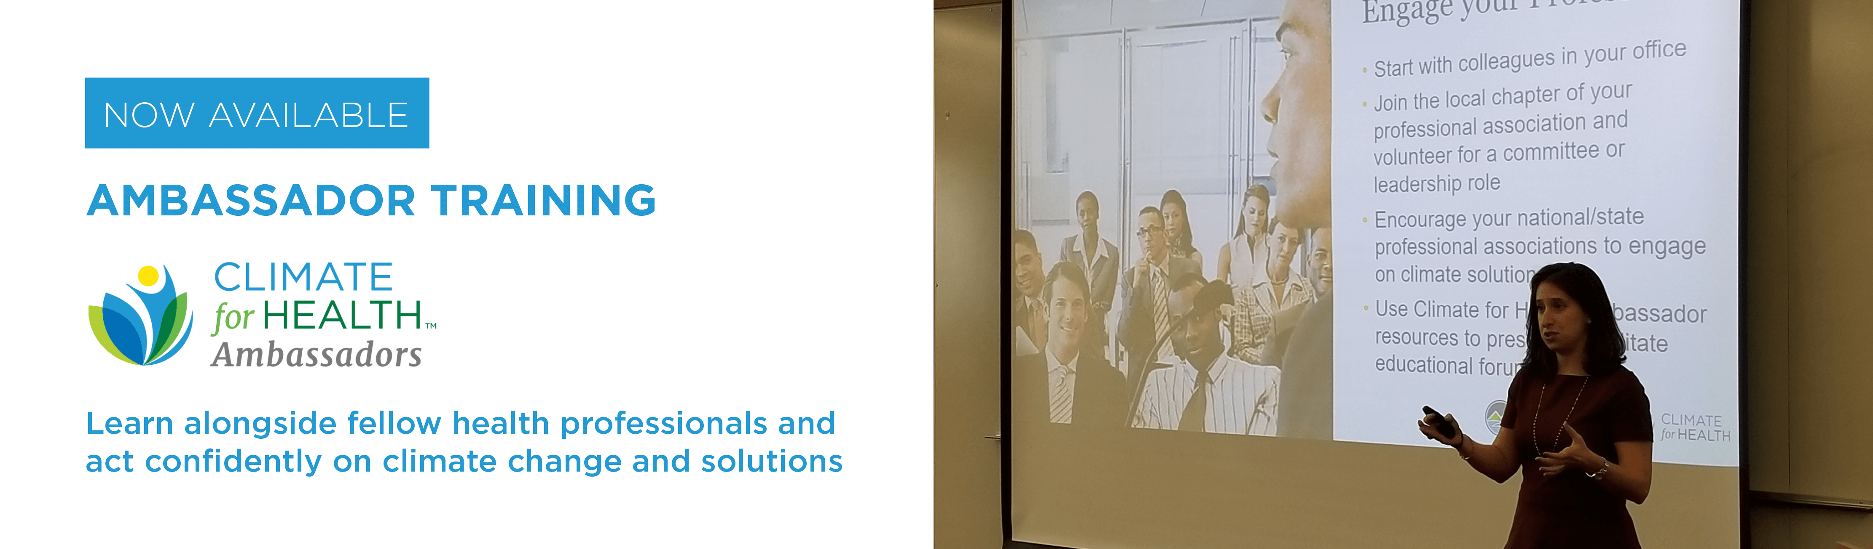
NACHC & ecoAmerica Partnership

Slide 51
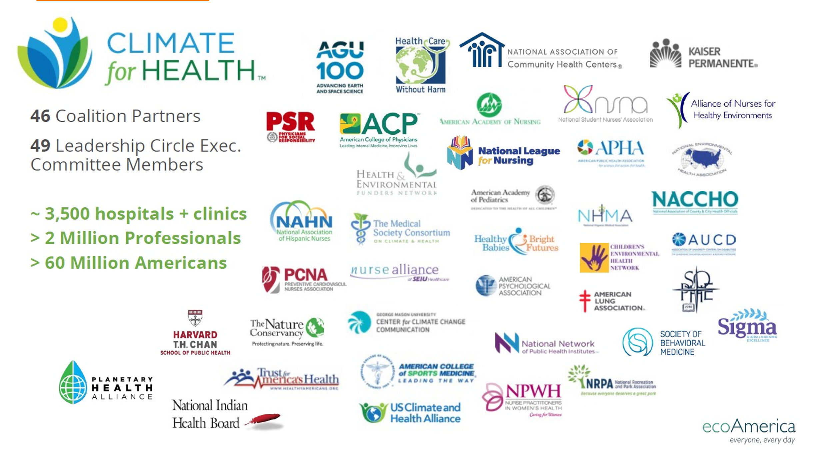
ecoAmerica
Notes:
ecoAmerica builds institutional leadership, public support, and political resolve for climate action and advocacy in the United States. Through their programs and network of nearly 100 trusted national organizations and affiliates, ecoAmerica reaches into local communities across the nation with training and ideas to take action on climate change.

Slide 52
PARTNERSHIP GOALS
Share key messages and raise awareness about the ways that climate change impacts health
  Climate for Health Ambassador Program (in person or online)
  Publications/Guides
  Feature health centers in webinars/podcasts
Tailor ecoAmerica resources to highlight health center stories and context
Foster collective impact through online engagement/connection to network for continued learning and action
  MomentUS platform
Notes:
As partners NACHC and ecoAmerica will work together to create and tailor ecoAmerica’s resources for health center audiences, which are completely free of charge. The ultimate goal is to provide ready and easy to use learning modules and written resources that raise awareness about how climate change impacts health and ideas to take action.
Our goals include:
Share key messages to raise awareness. This includes the signature climate for health ambassador program, publications and guides, and also ecoAmerica wishes to feature health centers in webianrs and podcasts
ecoAmerica and NACHC are working to capture how health centers are taking action on climate change and environmental issues. We are in the process of recording these stories, which will then be embeeded in the climate for health ambassador program.
Continued engagement and connection to a network through the momentus platform after completing the climate for health ambassador program
Current Status: ecoAmerica has updated their training which is now available.
NACHC is in the process of recording health centers stories to showcase examples of work on env. Climate change. If you know a health center that would like to be featured- please let us know!
After we get health center stories recorded, we will meet with an advisory group for more in depth feedback on all the different resources and training. If you would like to be part of this advisory group, please let me know.

Slide 53
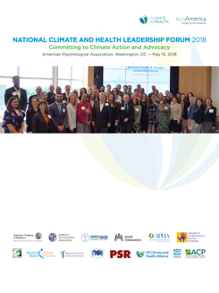

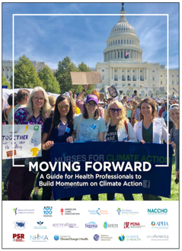


CLIMATE FOR HEALTH
Leadership
Communication Resources
Education and Engagement
Action
Notes:
Key components of ecoAmerica’w work includes:
Convening health leaders across the country to elevate their visible leadership on climate change at events like our American Climate Leadership Summit and our National Health and Climate Forums
Conducting research on attitudes and awareness levels of health professionals on the issue of climate change
Issuing guidance for communicating about health and climate that is accessible and motivating
Providing educational opportunities and model climate conversations in many different contexts through our Ambassador programs and our Let’s Talk Climate webcast series
Providing a number of other resources to inspire people to take action on climate in their local communities
All of these resources are available on NACHC’s webpage and we will update them to fit health center needs

Slide 54
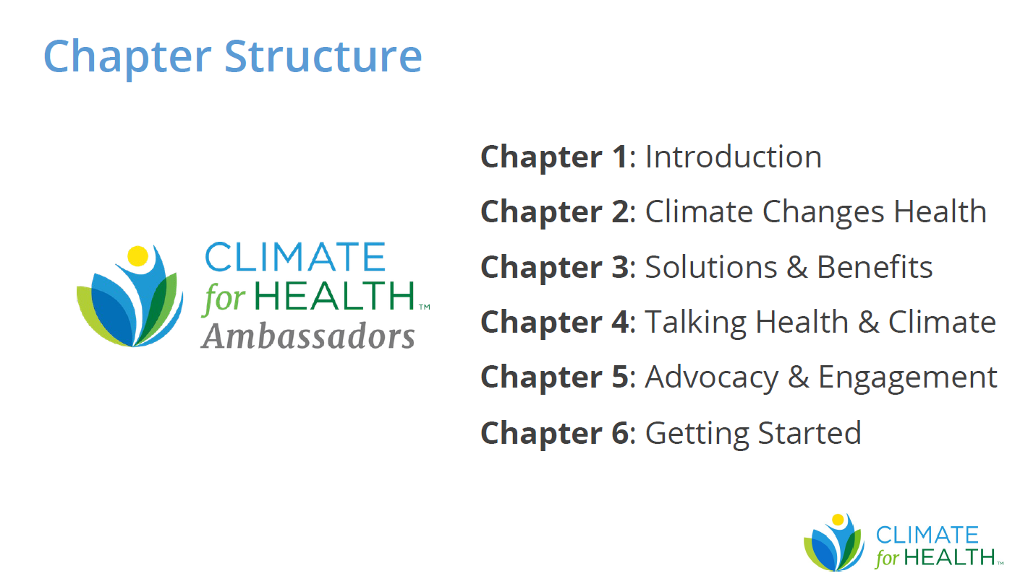
KEY TRAINING COMPONENTS: AMBASSADORS PROGRAM
Notes:
3 to 4 hour online training
The chapters of the training listed in the slide

Slide 55
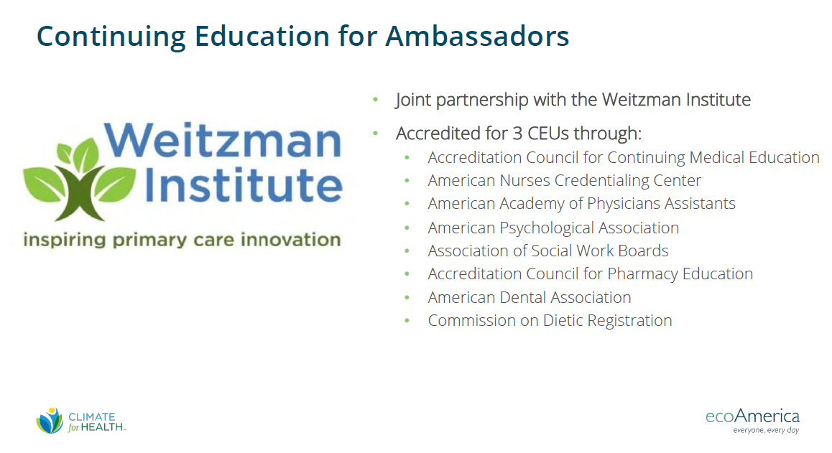
EARN CEUs
Notes:
The ambassador training is also now accredited for continuing education credits for numerous health professions listed in the slide

Slide 56

Accelerating Clinician Awareness and Engagement
The Medical Society Consortium on Climate and Health, in collaboration with NACHC, is receiving funding from the Mosaic Foundation to build and disseminate a toolkit that will include 3 levels of engagement:
Administrators: NACHC will develop a component of the toolkit that offers a turnkey approach to take advantage of IRA and IIJA funds to invest in solar, HVAC systems, and electrification to improve resilience and health.
Health Professionals: MSCCH will develop a component of the toolkit for our state clinician groups, to catalyze investments in community health center climate resilience and to improve patients’ access to IRA funds to improve their own home resilience and health. This will include state specific communications resources for solar and decarbonization, in addition to resources for administrators that outlines the economic case and provides tips and guidelines for accessing IRA funds.
Patients/Community members: The final element of the toolkit will also include materials for patients on available funding opportunities through IRA to improve their homes and health, including weatherization funds and EV subsidies, among others.

Slide 57
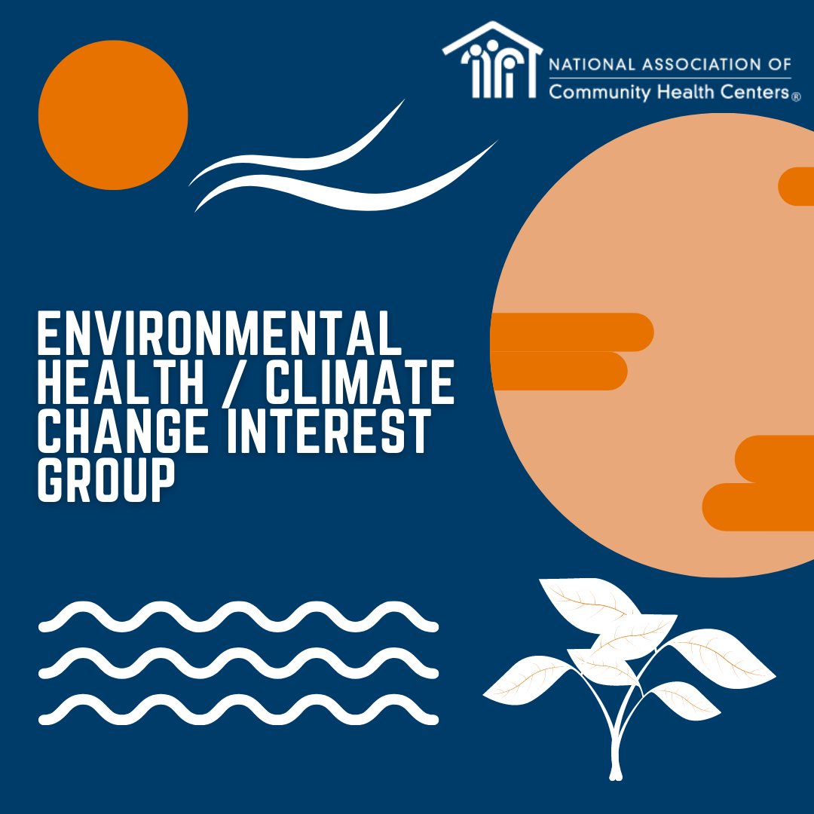

NACHC Environmental Health/Climate Change Interest Group
For questions/more information, email Jessica Hinshaw at jhinshaw@nachc.org

Slide 58
QUESTIONS?

Slide 59

E. Benjamin Money, Jr., MPH
Senior Vice President, Population Health
National Association of Community Health Centers
211 North Union St., Suite 200
Alexandria, VA 22314
bmoney@nachc.org

Slide 61
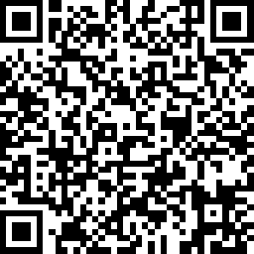
We want to hear from you!
https://www.surveymonkey.com/r/RCYLXYT
Notes:
Speaker: Please complete the post session survey to share your feedback. To access the survey, you can scan the QR code on this slide with the camera on your mobile phone! The survey should only take a minute or two to complete. Thank you!

Slide 62
Thank you for joining us!

