Slide 1

Education & Training Webinar: Cervical Health Awareness
January 22, 2026 | 12pm – 1pm

Slide 2

Disclaimer
The Louisiana Department of Health (LDH) employees, contractors, affiliates, et al. have no actual or potential conflict- of- interest in relation to this program presentation. The content herein is intended for general guidance, not as legal advice.
Laws and regulations take priority if there are any differences. Only LDH’s Secretary or Surgeon General can give official statements. LDH cannot speak for other government agencies, and if you need legal advice, you should consult a lawyer.

Slide 3
Objective
To drive collaboration throughout the state that connects communities to tools and resources that can improve the health of our residents where they live, work, learn, play and pray.

Slide 4
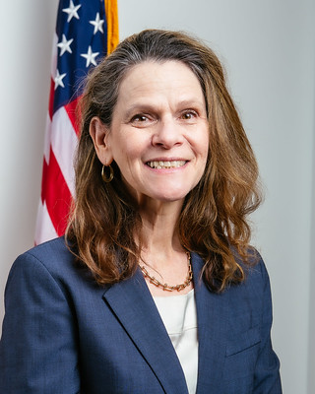
Welcome
Nancy Lowenthal, PhD, MPH
Bureau Director
Well-Ahead Louisiana
Bureau of Chronic Disease Prevention and Healthcare Access within Office of Public Health at Louisiana Department of Health
Notes:
Add name and credentials
Add Headshot

Slide 5

Speaker
Dr. Veronica Gillispie-Bell, MD, MAS, FACOG
Medical Director
Louisiana Perinatal Quality Collaborative and Pregnancy Associated Mortality Review
Louisiana Department of Health
Professor and System Medical Director of Health Outcomes
Ochsner Health
Notes:
Dr. Veronica Gillispie-Bell is a nationally recognized obstetrician-gynecologist, women’s health expert, and public health leader whose work focuses on improving health outcomes for women across the lifespan by transforming clinical care, health systems, and policy. With deep experience at the intersection of patient care, quality improvement, and health equity, her mission is to eliminate disparities and make women’s healthcare safer, more effective, and more responsive to the communities it serves.
She serves as System Medical Director of Health Outcomes and Medical Director of Quality for Women’s Services across Ochsner Health, where she leads system-wide strategies to improve clinical quality, safety, and outcomes in women’s healthcare. She also directs the Minimally Invasive Center for the Treatment of Uterine Fibroids and is a Professor at Xavier Ochsner College of Medicine. Clinically, Dr. Gillispie-Bell is known nationally for her expertise in managing heavy menstrual bleeding due to fibroids and performing advanced laparoscopic and robotic-assisted surgeries.
In addition to her clinical leadership, Dr. Gillispie-Bell is a nationally respected authority in public health and quality improvement. As Medical Director of the Louisiana Perinatal Quality Collaborative and Pregnancy-Associated Mortality Review for the Louisiana Department of Health, she has led statewide initiatives across more than 40 hospitals that have improved care processes, strengthened systems of accountability, and reduced severe maternal morbidity. Her work has helped shape both state and national approaches to improving women’s health outcomes through data-driven, equity-centered solutions.
Her expertise has informed federal and state policy, and she has testified before Congress, spoken at the inaugural White House Maternal Health Day of Action, and advised the U.S. Department of Health and Human Services and the Federal Communications Commission. Her research, supported by the National Institutes of Health and the U.S. Department of Health and Human Services, includes more than $16 million in federal grants advancing equity, quality, and safety in women’s healthcare.
Dr. Gillispie-Bell serves on several national committees, including the American College of Obstetricians and Gynecologists’ Committee on Clinical Practice Guidelines – Obstetrics, where she serves as Vice-Chair of the Committee, and the National Network of Perinatal Quality Collaboratives Executive Committee. Her leadership has been recognized with honors including the American Heart Association Women in STEM Award, Delta Omega Honor Society in Public Health, and Top Women Leaders of Louisiana. She also serves on the Board of Directors for Xavier Ochsner College of Medicine and the Board of Trustees at St. George’s Episcopal School.
A trusted national voice on women’s health, healthcare quality, and health equity, Dr. Gillispie-Bell has been featured on CNN, Good Morning America, and CNBC; appeared in The 1619 Project docuseries; written opinion pieces for The New York Times and USA Today and been quoted in many other national media.

Slide 6
Cervical Health Awareness:
What You Need to Know

Slide 7
No Woman Should Die From Cervical Cancer

Slide 8
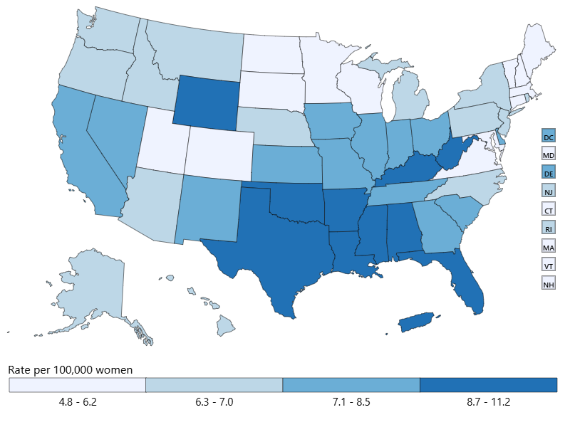
Incidence of Cervical Cancer
In 2022, in the US, there were 12,960 new cases of cervical cancer - 7 per 100,000 women.
In Louisiana, there were 1078 cervical cancer cases – 8.9 per 100,000 women.
Source U.S. Cancer Statistics Working Group, June 2025

Slide 9
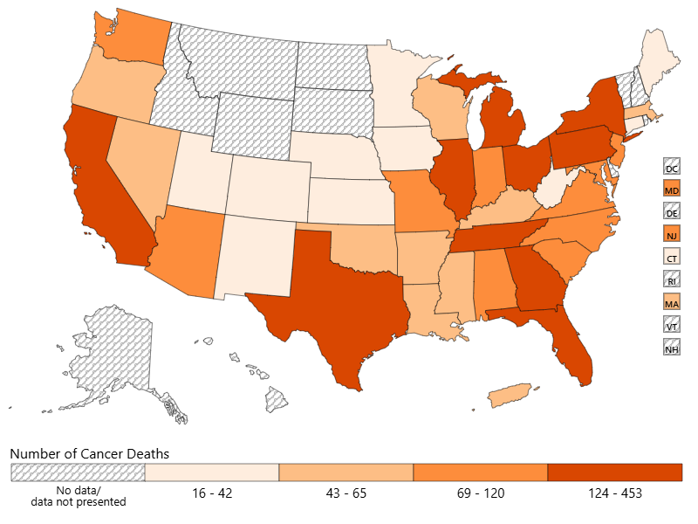
Number of Cancer Deaths, 2023
In 2023, in the US, 4,162 women died of cervical cancer.
In Louisiana, there were 65 deaths from cervical cancer.
Source U.S. Cancer Statistics Working Group, June 2025

Slide 10
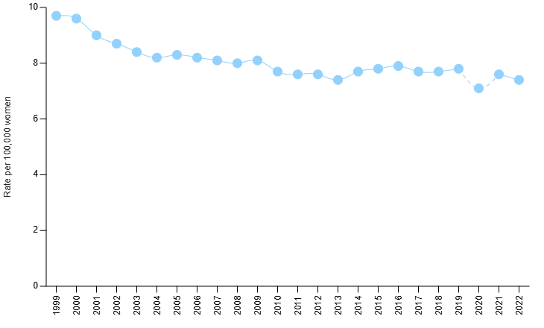
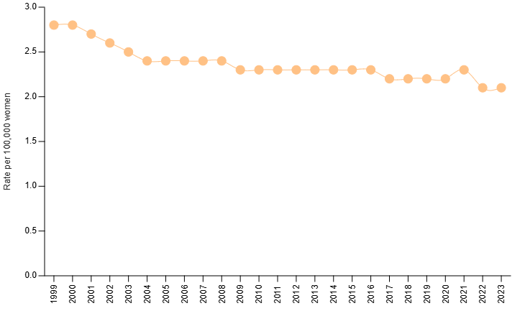
Trend in the Incidence of Cervical Cancer and Cancer Deaths
Since 1999, there has been a consistent decline in the incidence of cervical cancer, except in 2021
Cervical cancer screening rates were below pre-pandemic rates as recent as 2023
Source U.S. Cancer Statistics Working Group, June 2025

Slide 11
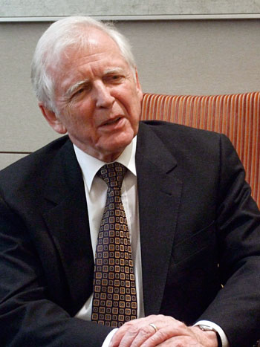
What We Know…
Nearly all cervical cancer is caused by high-risk Human Papilloma Virus
1979 – isolated HPV-6 and the link to genital warts
1983, 1984 – isolated HPV-16 and HPV-18 to be responsible for 70% of cervical cancers
1995 – the International Biological Study on Cervical Cancer studied cervical cancer samples from 22 countries – 93% could be linked to HPV
1999 – samples retested – 99.7% could be linked to HPV
Harald zur Hausen
Notes:
Won the Nobel Peace Prize in 2008

Slide 12
The Pathway for Eliminating Cervical Cancer
Eliminate Cervical Cancer
Early Detection: Cervical Cancer Screening
Prevention: HPV Vaccination

Slide 13

Cervical Cancer Screening Recommendations:
US Preventive Task Force Recommendations
American Cancer Society
Initiate Screening
21 years old
Age of screening
21 - 65 years old
Method of Screening
21 – 65 years old
Cytology every 3 years
30 – 65 years old
Cytology and HPV co-testing every 5-years
FDA-approved primary HPV testing only every 5-years
Cytology only every 3 years
Initiate Screening
25 years old
Age of screening
25 - 65 years old
Method of Screening
21 – 65 years old
Cytology every 3 years
30 – 65 years old
Cytology and HPV co-testing every 5-years
FDA-approved primary HPV testing only every 5-years
Cytology only every 3 years
Recommendation for self-collected vaginal specimen fro HPV testing

Slide 14
New HRSA-supported Women’s Preventive Services Guidelines
Patient-collected hrHPV testing is an appropriate method and should be offered as an option for cervical cancer screening in women aged 30 to 65 years at average risk.
Recommendation was based on the Enduring Consensus Cervical Cancer Screening and Management Guidelines Committee
Notes:
Average risk =
1. Has a cervix (i.e., women or transgender men who have not undergone hysterectomy with removal of the cervix)
2. Asymptomatic (i.e., does not have abnormal bleeding or other symptoms concerning cervical cancer for which a more thorough workup is required)
3. Screening for the first time or has a history of all normal cervical cancer screening results in the past; OR has a remote history of abnormal results that has been followed by a sufficient amount of normal testing that the individual fulfils criteria to resume routine cervical cancer screening based on follow-up recommendations from the Risk-Based Management Consensus Guidelines (Perkins 2020, 2024^{20, 21}).

Slide 15
Enduring Consensus Cervical Cancer Screening Management Guidelines
Clinician-collected cervical specimens are preferred, and self-collected vaginal specimens are acceptable for cervical cancer screening.
When self-collected specimens are HPV-negative, repeat testing in 3-years is recommended.
When self-collected specimens are positive for HPV 16 and/or 18, colposcopy and cytology are recommended.
When self-collected specimens are positive for other high-risk HPV type, clinician-collected specimens are recommended.
When self collected vaginal specimens are positive for non-high-risk HPV, repeat testing in 1-year is recommended.
In the surveillance setting, clinician-collected cervical specimens are preferred
Notes:
The Enduring Consensus Cervical Cancer Screening and Management Guidelines (Enduring Guidelines) effort is a standing committee to continuously evaluate new technologies and approaches to cervical cancer screening, management, and surveillance. American Academy of Family Physicians, American Cancer Society, American College of Nurse-Midwives, American College of Obstetricians and Gynecologists, American Sexual Health Association, American Society for Clinical Pathology, American Society of Cytopathology, ASCCP, Association for Physician Assistants in Obstetrics and Gynecology, Cervivor, College of American Pathologists, National Cancer Institute, Nurse Practitioners in Women's Health, Nurses for Sexual and Reproductive Health, Papanicolaou Society of Cytopathology, Planned Parenthood Federation of America, Society of Gynecologic Oncology, Team Maureen, Women Veterans Health Strategic Healthcare Group,

Slide 16
HPV Vaccination
The HPV vaccine should be given to children between 11-12 years old (can be given at 9 years old)
Since 2006, among young adult women, infections with HPV types that cause most HPV cancers and genital warts have dropped 81 percent.
Since 2006, among vaccinated women, the percentage of cervical precancers caused by the HPV types most often linked to cervical cancer has dropped by 40 percent.
Notes:
Average risk =

Slide 17
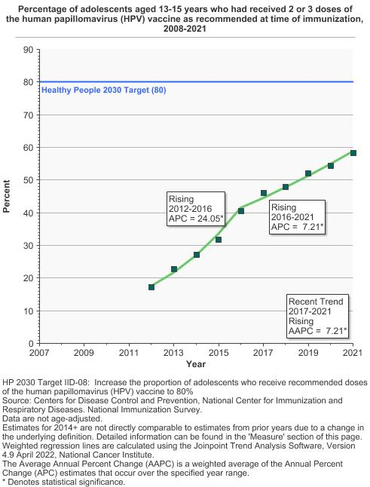
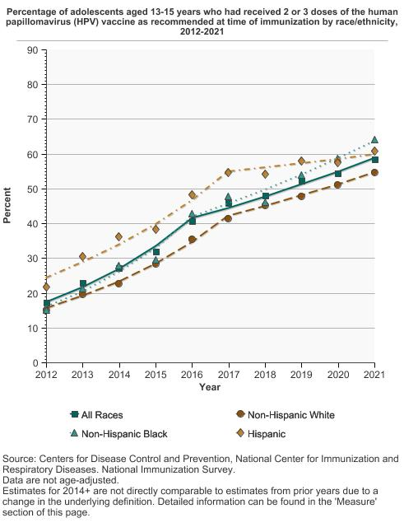
HPV Vaccination Rates
Notes:
Average risk =

Slide 18
Barriers to Cervical Cancer Screening
Financial
Required to be covered by all insurance plans by the Affordable Care Act but does not apply to plans BEFORE September 23, 2010
Lack of transportation
Lack of childcare
Having to take off time from work
Lack of knowledge
Notes:
The Enduring Consensus Cervical Cancer Screening and Management Guidelines (Enduring Guidelines) effort is a standing committee to continuously evaluate new technologies and approaches to cervical cancer screening, management, and surveillance. American Academy of Family Physicians, American Cancer Society, American College of Nurse-Midwives, American College of Obstetricians and Gynecologists, American Sexual Health Association, American Society for Clinical Pathology, American Society of Cytopathology, ASCCP, Association for Physician Assistants in Obstetrics and Gynecology, Cervivor, College of American Pathologists, National Cancer Institute, Nurse Practitioners in Women's Health, Nurses for Sexual and Reproductive Health, Papanicolaou Society of Cytopathology, Planned Parenthood Federation of America, Society of Gynecologic Oncology, Team Maureen, Women Veterans Health Strategic Healthcare Group,

Slide 19
Common Objections to HPV Vaccination
Would you give the HPV vaccine to your child?
Why does my child need the HPV vaccine?
What diseases are caused by HPV?
Is my child at risk for HPV?
How do you know the HPV vaccine works?
I’m worried getting the vaccine will make my child think having sex is OK?
Why do they need the HPV vaccine at such a young age?
I’m worried about the safety of the HPV vaccine. Is it safe?
Why do boys need the HPV vaccine?

Slide 20
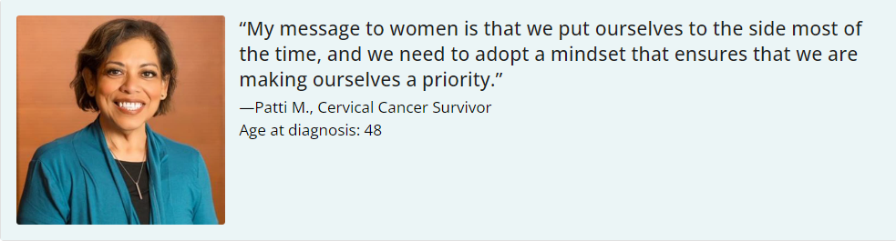
Testimonial
Notes:
I am a retired New York City police officer and reside in New York City with my husband of 22 years. I am also a 12-year cervical cancer survivor.
Three months before my retirement I started bleeding between menstrual cycles. I accredited it to being stressed since I was getting ready to wrap up a 20-year career. At the time, I had not seen a gynecologist in 3 years. Why? Well, my gynecologist had retired, and I didn’t look for a new one. I didn’t feel the dire need to find one since I felt fine. I had no symptoms whatsoever. I had been married for 10 years and I was in a monogamous relationship. However, the progressive bleeding, fatigue, and bloating pushed me to go see a doctor.
I went to a new gynecologist, where she took a biopsy, which came back inconclusive. She told me she needed to refer me to a gynecologic oncologist. When I went to the oncologist, he took another biopsy and those results revealed I had cervical cancer, stage IIB.
My diagnosis has made me a passionate cervical cancer advocate, especially for Hispanic women or Latinas, who have a higher risk for it. Cervical cancer can be prevented. We have the tools to do this: screening, education, and vaccination.
My message to women is that we put ourselves to the side most of the time, and we need to adopt a mindset that ensures that we are making ourselves a priority. Health is a big priority for me now because without it, not a lot of things matter—like being able to help my loved ones. With this mindset, we can close the door to so many illnesses. We all have to take care of ourselves because health is wealth.

Slide 21
Summary
Cervical cancer is preventable through HPV vaccination
Early detection through cervical cancer screening can reduce the rates of cervical cancer
There are barriers to both HPV vaccination and cervical cancer screening that must be addressed on an individual and system level

Slide 22
References
U.S. Cancer Statistics Working Group. U.S. Cancer Statistics Data Visualizations Tool. U.S. Department of Health and Human Services, Centers for Disease Control and Prevention and National Cancer Institute; https://www.cdc.gov/cancer/dataviz, released in June 2025.
Star J, Han X, Smith RA, Schafer EJ, Jemal A, Bandi P. Cancer Screening 3 Years After the Onset of the COVID-19 Pandemic. JAMA. 2025;333(17):1543–1546. doi:10.1001/jama.2025.0902.
Cervical Cancer: Screening. US Preventive Services Task Force. March 10, 2022. Recommendation: Cervical Cancer: Screening | United States Preventive Services Taskforce (uspreventiveservicestaskforce.org)
The American Cancer Society Guidelines for the Prevention and Early Detection of Cervical Cancer. American Cancer Society. April 22, 2021. The American Cancer Society Guidelines for the Prevention and Early Detection of Cervical Cancer | American Cancer Society.
Perkins, R. B., Wolf, A. M. D., Church, T. R., Elkin, E. B., Skates, S. J., Etzioni, R. D., Guerra, C. E., Herzig, A., Hoffman, R. M., Oeffinger, K. C., Raoof, S., Shih, Y. T., Walter, L. C., Zeigler-Johnson, C., Manassaram-Baptiste, D., & Smith, R. A. (2026). Self-collected vaginal specimens for human papillomavirus testing and guidance on screening exit: An update to the American Cancer Society cervical cancer screening guideline. CA: a cancer journal for clinicians, 76(1), e70041. https://doi.org/10.3322/caac.70041
Health Resources & Services Administration. (2025, December). Women’s preventive services guidelines. U.S. Department of Health & Human Services. https://www.hrsa.gov/womens-guidelines. Retrieved January 5, 2026.
Christine, B., Bush, M., Thurakal, A., & Sheehy, A. M. (2026). New Cervical Cancer Screening Guidelines From the US Department of Health and Human Services: Strengthening Women's Preventive Health. JAMA, 10.1001/jama.2025.26456. Advance online publication. https://doi.org/10.1001/jama.2025.26456
Wentzensen, Nicolas MD, PhD1; Massad, L. Stewart MD2; Clarke, Megan A. PhD1; Garcia, Francisco MD, MPH3; Smith, Robert PhD4; Murphy, Jeanne PhD, CNM5; Guido, Richard MD6; Reyes, Ana MS7; Phillips, Sarah MS1; Berman, Nancy MSN, ANP-BC, NCMP, FAANP8; Quinlan, Jeffrey MD9; Lind, Eileen NP10; Perkins, Rebecca B. MD11; Enduring Consensus Cervical Cancer Screening and Management Guidelines Committee. Self-Collected Vaginal Specimens for HPV Testing: Recommendations From the Enduring Consensus Cervical Cancer Screening and Management Guidelines Committee. Journal of Lower Genital Tract Disease 29(2):p 144-152, April 2025. | DOI: 10.1097/LGT.0000000000000885
Zeno, E. E., Brewer, N. T., Spees, L. P., Des Marais, A. C., Sanusi, B. O., Hudgens, M. G., Jackson, S., Barclay, L., Wheeler, S. B., & Smith, J. S. (2022). Racial and ethnic differences in cervical cancer screening barriers and intentions: The My Body My Test-3 HPV self-collection trial among under-screened, low-income women. PloS one, 17(10), e0274974. https://doi.org/10.1371/journal.pone.0274974
Akinlotan, M., Bolin, J. N., Helduser, J., Ojinnaka, C., Lichorad, A., & McClellan, D. (2017). Cervical Cancer Screening Barriers and Risk Factor Knowledge Among Uninsured Women. Journal of community health, 42(4), 770–778. https://doi.org/10.1007/s10900-017-0316-9
Suk R, Hong Y, Rajan SS, Xie Z, Zhu Y, Spencer JC. Assessment of US Preventive Services Task Force Guideline–Concordant Cervical Cancer Screening Rates and Reasons for Underscreening by Age, Race and Ethnicity, Sexual Orientation, Rurality, and Insurance, 2005 to 2019. JAMA Netw Open. 2022;5(1):e2143582. doi:10.1001/jamanetworkopen.2021.43582
Meites E, Szilagyi PG, Chesson HW, Unger ER, Romero JR, Markowitz LE. Human Papillomavirus Vaccination for Adults: Updated Recommendations of the Advisory Committee on Immunization Practices MMWR. 2019;68(32);698-702.
Human papillomavirus vaccination. ACOG Committee Opinion No. 809. American College of Obstetricians and Gynecologists. Obstet Gynecol 2020;136:e15–21.
Centers for Disease Control and Prevention. (2024, August 20). HPV vaccination. U.S. Department of Health & Human Services. Retrieved January 5, 2026, from https://www.cdc.gov/hpv/vaccines/#cdc_vaccine_basics_get_vaccinated-why-getting-vaccinated-is-important

Slide 23

FOR MORE INFO
Dr. Veronica Gillispie-Bell, MD, MAS, FACOG
veronica.gillispie@la.gov

Slide 24
Questions?
Notes:
At this time, we will have our Q&A Segment…for ALL medical questions and/or advice, please consult your physician. Feel free to drop your questions in the Q&A Box and you will be acknowledged by one of our team members.
1. What common myths or misconceptions about cervical cancer do you often encounter, and how can women better protect themselves from misinformation?
2. What are some common symptoms of cervical cancer?
3. For women who may have limited access to healthcare, what practical advice or resources would you recommend to help them stay proactive about cervical cancer prevention?

Slide 25
Closing Remarks
Nancy Lowenthal, PhD, MPH
Bureau Director
Well-Ahead Louisiana
Bureau of Chronic Disease Prevention and Healthcare Access within Office of Public Health at Louisiana Department of Health

Slide 26
Well-Ahead Louisiana | Louisiana Department of Health
Contact us: WellAhead@la.gov
Please also feel free to visit the Well-Ahead website at: http://wellaheadla.com
Call: 1-844-522-4323
Notes:
Again, we thank you all for joining in today’s webinar & a huge THANK YOU to our speaker _________________________
We are walking away today more Enlighted and empowered!
To find out more about Well-Ahead and our numerous programs and services, please visit www.wellaheadla.com or contact us at wellahead@la.gov or call 1-844-522-4323.

