Slide 1

Education & Training Webinar:
Women’s Health Awareness
October 30, 2025 | 1pm – 2pm

Slide 2

Disclaimer
The Louisiana Department of Health (LDH) employees, contractors, affiliates, et al. have no actual or potential conflict- of- interest in relation to this program presentation. The content herein is intended for general guidance, not as legal advice.
Laws and regulations take priority if there are any differences. Only LDH’s Secretary or Surgeon General can give official statements. LDH cannot speak for other government agencies, and if you need legal advice, you should consult a lawyer.

Slide 3
Objective
To drive collaboration throughout the state that connects communities to tools and resources that can improve the health of our residents where they live, work, learn, play and pray.

Slide 4
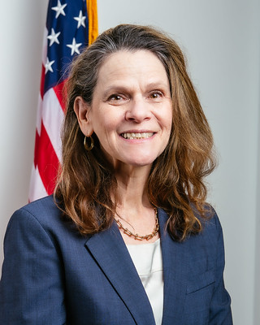
Welcome
Nancy Lowenthal, PhD, MPH
Bureau Director
Well-Ahead Louisiana
Bureau of Chronic Disease Prevention and Healthcare Access within Office of Public Health at Louisiana Department of Health
Notes:
Add name and credentials
Add Headshot

Slide 5
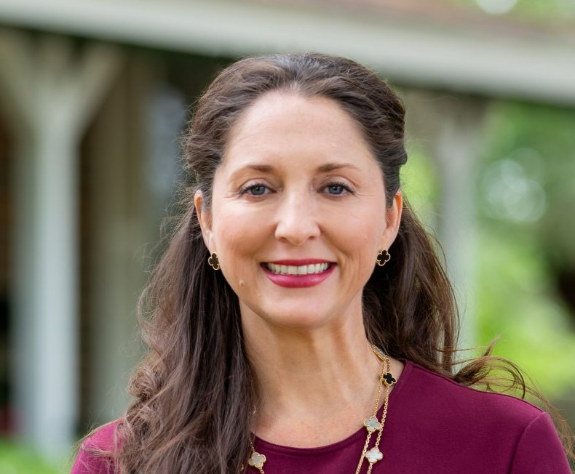
Speaker
Christina Lord, MD, FACOG, NMCP
Region VI Medical Director
LDH Office of Public Health
Christina.Lord@la.gov
Notes:
Dr. Christina Lord, MD, FACOG is a native of Vernon Parish and is “honored” to serve our community as the Regional Medical Director for Region 6 Office of Public Health. After having completed her Obstetrics and Gynecology residency from the University of Texas Medical Branch Galveston in 2004, she proudly returned back to central Louisiana (CenLA) to open a private practice OB/GYN office in Leesville, and has been taking care of women in rural Louisiana since then. She feels that having years of study, within the department of Microbiology at LSU Baton Rouge and then in medical school at LSU Health Sciences Center Shreveport, provided a valuable foundation on which to better understand public health outcomes in our state.
Dr. Lord currently volunteers on several committees within the Louisiana State Medical Society, is the Vice Chair for the Louisiana Section of the American College of Obstetricians and Gynecologists, and is the Past Chair 2023 for the Greater Vernon Chamber of Commerce.
“Finding a way to positively impact the lives of the folks that live and work in my area is what it’s all about, and I want to continue to do that!” says Dr. Lord. “Having a “local” help advocate” is to our advantage as we work together to support our OPH mission of protecting and promoting the health and wellness of all individuals living in Louisiana. #GeauxTigers #GeauxWampusCats #GeauxCenla #GeauxOPH #GeauxLDH

Slide 6
Menopause Awareness Month
“We do not care club……”

Slide 7
Perimenopause: the transitional phase before menopause ranging from 8-10 years prior to the last menstrual period
Menopause: 12 consecutive months without a menstrual period
10/30/2025
Wellness Webinar
7

Slide 8
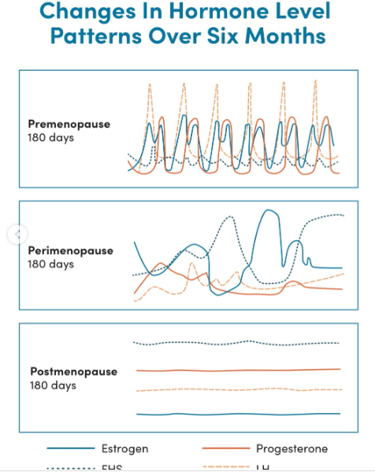
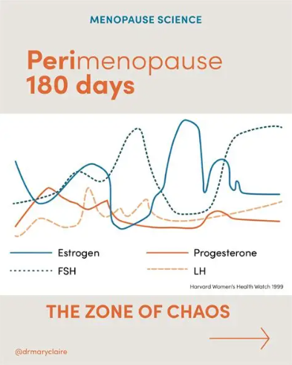
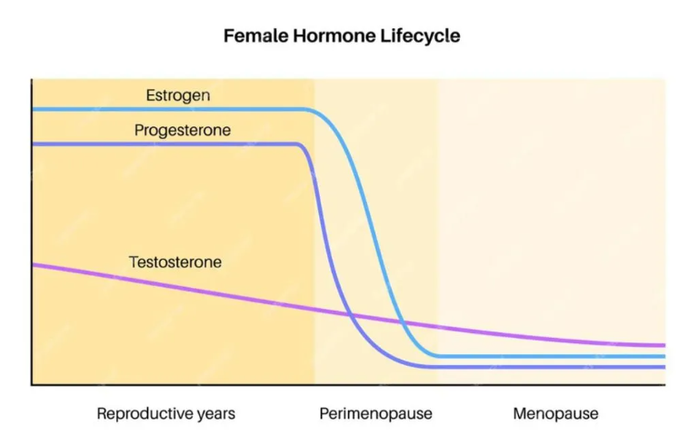


Slide 9
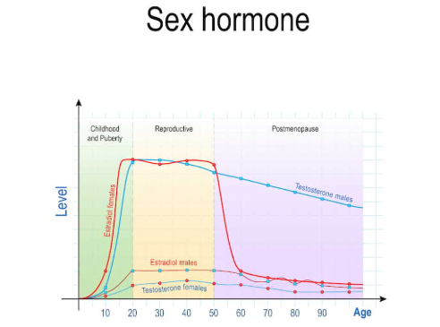

Slide 10
Common Symptoms:
Hot flashes
Night sweats
Mood changes
Brain fog
Joint pain….
fatigue, weight gain, anxiety, depression, panic attacks, sleep disturbances, sexual dysfunction, heart palpitations, hair loss, itchy skin, dry mouth, dry vagina, leakage of urine, digestive issues, more headaches, dizziness, tingling in extremities, and the list goes on.
10/30/2025
Wellness Webinar
10

Slide 11
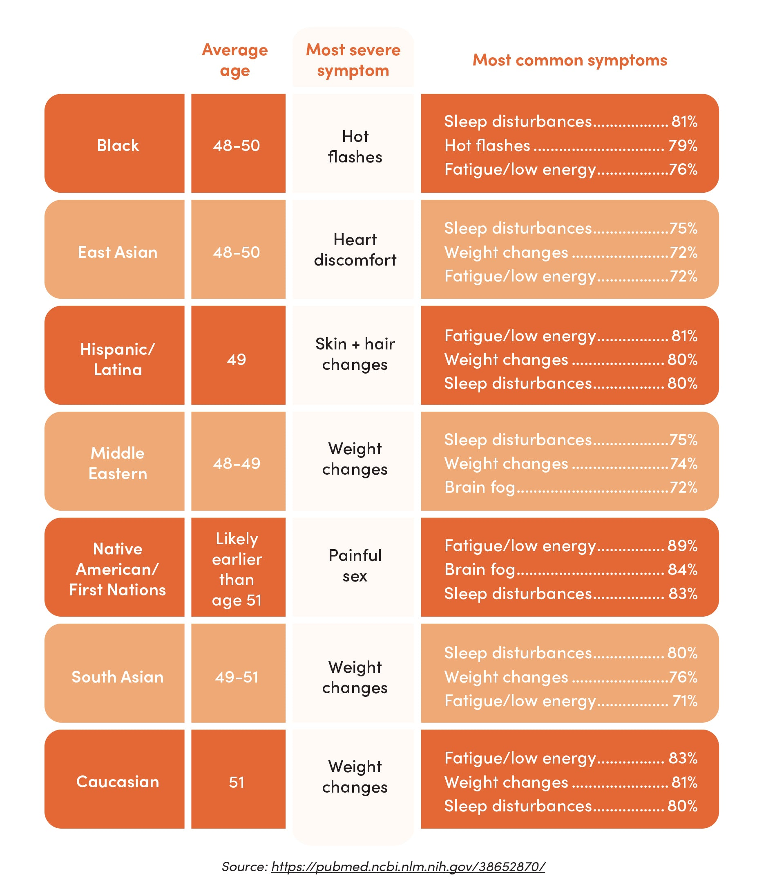

Slide 12
Cardiovascular Disease in Louisiana
#1 killer of women in Louisiana
Risk increases after menopause
10/30/2025
Wellness Webinar
12

Slide 13
Chronic Diseases increase as estrogen levels decrease
Osteoporosis
Neurologic disorders
Mental Health diagnosis
Auto Immune diseases
Genitourinary diseases
Musculoskeletal disorders
10/30/2025
Wellness Webinar
13

Slide 14
Call to Action
To improve Louisiana’s health rankings, we must prioritize care for women over 40 and address menopause-related health issues.
10/30/2025
Wellness Webinar
14

Slide 15
For now……
Hormone therapy can alleviate symptoms and reduce risks of osteoporosis and heart disease when started early
Your Habits Matter: diet, exercise, smoking cessation
Sleep is Critical: protect your sleep
Decrease Visceral Fat: increase fiber, reduce sugar, no alcohol
Maintain Bone Health: Vitamin D levels, weight bearing exercise
10/30/2025
Wellness Webinar
15

Slide 16

FOR MORE INFO
https://menopause.org/professional-resources/step-by-step-nm
https://thepauselife.com/blogs/the-pause-blog/menopause-and-cardiovascular-risk?_pos=4&_sid=508b2197c&_ss=r
https://www.acog.org/womens-health/faqs/the-menopause-years

Slide 17
Notes:
At this time, we will have our Q&A Segment…for ALL medical questions and/or advice, please consult your physician. Feel free to drop your questions in the Q&A Box and you will be acknowledged by one of our team members.
NOTE TO FACILITATOR: If questions are not immediate then ask the panel these questions to fill in time lapse:
What are some factors that you think are most predictive of successful compliance with nutrition?
Can exercising and dieting assist with nutrition complications?
Can you discuss some of the key health promotion recommendations to improve care, enhance quality of life and prevent complications with bad eating habits?
I know that you have covered some of this in your presentation, but what are some of the best ways to practice healthy eating habits in work settings?

Slide 18
Closing Remarks
Nancy Lowenthal, PhD, MPH
Bureau Director
Well-Ahead Louisiana
Bureau of Chronic Disease Prevention and Healthcare Access within Office of Public Health at Louisiana Department of Health

Slide 19
Well-Ahead Louisiana | Louisiana Department of Health
Contact us: WellAhead@la.gov
Please also feel free to visit the Well-Ahead website at: http://wellaheadla.com
Call: 1-844-522-4323
Notes:
Again, we thank you all for joining in today’s webinar & a huge THANK YOU to our keynote speaker______________________________.
We are walking away today more Enlighted and empowered!
To find out more about Well-Ahead and our numerous programs and services, please visit www.wellaheadla.com or contact us at wellahead@la.gov or call 1-844-522-4323.

