Slide 1

Education & Training Webinar: Mental Health Awareness
December 11, 2025 | 1pm – 2pm

Slide 2

Disclaimer
The Louisiana Department of Health (LDH) employees, contractors, affiliates, et al. have no actual or potential conflict- of- interest in relation to this program presentation. The content herein is intended for general guidance, not as legal advice.
Laws and regulations take priority if there are any differences. Only LDH’s Secretary or Surgeon General can give official statements. LDH cannot speak for other government agencies, and if you need legal advice, you should consult a lawyer.

Slide 3
Objective
To drive collaboration throughout the state that connects communities to tools and resources that can improve the health of our residents where they live, work, learn, play and pray.

Slide 4
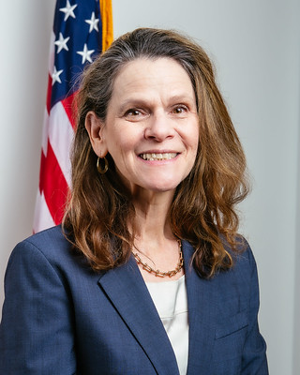
Welcome
Nancy Lowenthal, PhD, MPH
Bureau Director
Well-Ahead Louisiana
Bureau of Chronic Disease Prevention and Healthcare Access within Office of Public Health at Louisiana Department of Health
Notes:
Add name and credentials
Add Headshot

Slide 5
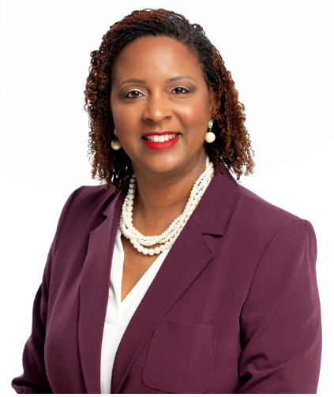
Speaker
Dr. Erica Joseph, PhD, DNP, PMHNP-BC, FNP-C, MD
Adult Psych/Mental Health Nurse Practitioner
Family Nurse Practitioner
Notes:
Dr. Erica Joseph holds dual national board certifications as an Adult Psychiatric Mental Health Nurse Practitioner and Family Nurse Practitioner. Dr. Joseph has been a member of the nursing profession for twenty-five years. She has worked as a Nurse Practitioner in the specialty area of psychiatry/mental health the past 17 years. She earned her Bachelor of Science in Nursing in December 1999 and Master of Science in Nursing in May 2008 from Southern University & A&M College. She earned a Post-Master in Psychiatry/Mental Health from Southeastern Louisiana University in December 2012. She completed the Doctor of Nursing Practice program at Southern University in December 2015 and the Doctor of Philosophy in Nursing during the Spring 2020 semester at the height of the global pandemic. She is an alumni of the Substance Abuse Mental Health Administration (SAMHSA) Minority Fellowship Program (MFP) through American Nurses Association (ANA).
Dr. Joseph’s research interest is examining risk and protective factors of minorities identified as high risk for suicide. Over the past 17 years, she has been committed to raising awareness of suicide prevention efforts and to the understanding of mental and substance use disorders. “Dr. J” as she is affectionately known by her clients, has been employed as Co-Team Lead of the Mental Health Intensive Case Management Program at the Southeast Louisiana Veterans Healthcare System where she helped to start the program at the Baton Rouge Outpatient Clinic. She is owner of Transformative Health, L.L.C. and Founder of TransforMe, a non-profit to address this important work.
Dr. Joseph has received numerous accomplishments and recognitions which includes being selected by American Psychiatric Nurses Association (APNA) as a Champion for Tobacco Cessation. She was selected as the 2015 Louisiana Nurses Foundation, Advanced Practice Nurse of the Year. In October 2015, Dr. Joseph was selected as one of ten nurses to receive the national honor as a Robert Wood Johnson Foundation and AARP, Culture of Health Breakthrough Nurse Leader. In October 2019, she was recognized as one of the Great 100 Nurses of Louisiana. In 2019, Dr. Joseph was the recipient of a personal coin from the Honorable Secretary of Veterans Affairs, Robert Wilkie, for providing excellence in healthcare to our nation’s heroes. She is the recipient of the Honorary Doctorate in Humanitarianism from Leaders Esteem Christian Bible University. She is the Past President of the Louisiana Chapter of American Psychiatric Nurses Association and past member of the National Nominating Committee and current National Board of Directors of the American Psychiatric Nurses Association.

Slide 6
Anxiety, Depression & Holiday Blues:
How to Manage Your Health & Well-Being During the Holidays and Beyond

Slide 7
Anxiety
Most common mental illnesses in America
Feelings of apprehension or unexplained feelings of impending doom
Involves more than temporary worry and fear
Persistent, excessive worry and fear in situations that are not threatening
Several types of anxiety disorders

Slide 8
What does anxiety look like?
Excessive worry
Feelings of apprehension or dread
Restlessness
Difficulty concentrating
Irritability
Muscle pain, tightness, soreness
Difficulty sleeping
Feeling tense and jumpy

Slide 9
Depression
Leading cause of disability in the United States
A common and serious illness but many individuals who exhibit symptoms of this illness do not seek treatment
When depression goes unrecognized or untreated there is potential for tragic consequences such as suicide and impaired relationships at work and at home

Slide 10
What Does Depression Look Like?
Depressed mood (sadness, tearfulness, emptiness)
Loss of interest in things
Difficulty with sleep
Difficulty with concentration
Changes in appetite
Anger outbursts
Agitation
Feelings of worthlessness
Feelings of hopelessness
Unexplained Physical Problems
Thoughts of death by suicide

Slide 11
Suicide
Suicide has been identified as a major public health problem, not just a mental health concern
Suicide is the 11th leading cause of death within the U.S.
Nearly 49,000 deaths per year, which amounts to 1 person every 11 minutes

Slide 12
Suicide
Family history of suicide
Previous suicide attempts
Past childhood trauma
History of mental disorders
History of alcohol and substance abuse
Feelings of hopelessness
Loss (financial, relational, social and work)
Physical Illness
Unwillingness to seek treatment due to stigma

Slide 13
Warning Signs of Suicide
I Ideation / threatened or communicated S Substance abuse / excessive or increased? P Purposelessness / no reasons for living A Anxiety /agitation / insomnia T Trapped / feeling no way out H Hopelessness / nothing will ever change W Withdrawal from friends, family, society A Anger (uncontrolled)/ rage / seeking revenge R Recklessness/ risky acts / unthinking M Mood changes (dramatic)

Slide 14
Holiday Blues
Excessive worry
Sadness
Stress
Difficulty sleeping
Feelings of guilt
Changes in appetite and weight
Irritability
Feelings of being tired
Not persistent, last brief time

Slide 15
Coping Through The Holidays
Get enough sleep
Proper nutrition
Exercise
Explore your interests
Don’t isolate yourself
Connect with a support group
Mindfulness exercises
Ask for Help
Volunteer or support a cause

Slide 16
Resources
988 Call, Text, Chat, Suicide & Crisis Lifeline
National Alliance on Mental Illness www.nami.org
Substance Abuse and Mental Health Services Administration www.samhsa.gov
Psychology Today www.psychologytoday.com

Slide 17

FOR MORE INFO
Dr. Erica Joseph, PhD, DNP, PMHNP-BC, FNP-C
ethomas39@yahoo.com

Slide 18
Notes:
At this time, we will have our Q&A Segment…for ALL medical questions and/or advice, please consult your physician. Feel free to drop your questions in the Q&A Box and you will be acknowledged by one of our team members.
What are the most effective ways to reduce mental health stigma?
How can community partners help improve access to mental health support?
What policy changes would most improve mental health outcomes?

Slide 19
Closing Remarks
Nancy Lowenthal, PhD, MPH
Bureau Director
Well-Ahead Louisiana
Bureau of Chronic Disease Prevention and Healthcare Access within Office of Public Health at Louisiana Department of Health

Slide 20
Well-Ahead Louisiana | Louisiana Department of Health
Contact us: WellAhead@la.gov
Please also feel free to visit the Well-Ahead website at: http://wellaheadla.com
Call: 1-844-522-4323
Notes:
Again, we thank you all for joining in today’s webinar & a huge THANK YOU to our speaker _________________________
We are walking away today more Enlighted and empowered!
If you may be experiencing thoughts of suicide, please dial 9-8-8 for support from a team of certified experts.
To find out more about Well-Ahead and our numerous programs and services, please visit www.wellaheadla.com or contact us at wellahead@la.gov or call 1-844-522-4323.

